Slide 1


Database Management Systems
Grant and Revoke
Prof. Bhargavi M & Prof. Vidhyashree DM
Dept of Computer Science and Engineering

Slide 2




Database Management Systems
Introduction to DB Security
Secrecy: Users should not be able to see things they are not supposed to.
E.g., A student can’t see other students’ grades.
Integrity: Users should not be able to modify things they are not supposed to.
E.g., Only instructors can assign grades.
Availability: Users should be able to see and modify things they are allowed to.

Slide 3



Database Management Systems
Threats to Database
Loss of integrity: Database integrity refers to the requirement that information be protected from improper modification. Modification of data includes creating, inserting, and updating data; changing the status of data; and deleting data. Integrity is lost if unauthorized changes are made to the data by either intentional or accidental acts.
Loss of availability: Loss of availability occurs when the user or program cannot access these objects.
Loss of confidentiality: Database confidentiality refers to the protection of data from unauthorized disclosure.

Slide 4


Database Management Systems
Access Controls
A security policy specifies who is authorized to do what.
A security mechanism allows us to enforce a chosen security policy.
Two main mechanisms at the DBMS level:
Discretionary access control
Mandatory access control

Slide 5
Database Management Systems
Discretionary Access Control
Based on the concept of access rights or privileges for objects (tables and views), and mechanisms for giving users privileges (and revoking privileges).
Creator of a table or a view automatically gets all privileges on it.
DBMS keeps track of who subsequently gains and loses privileges, and ensures that only requests from users who have the necessary privileges (at the time the request is issued) are allowed.

Slide 6
Mandatory security mechanisms
Database Management Systems
These are used to enforce multilevel security by classifying the data and users into various security classes and then implementing the appropriate security policy of the organization.

Slide 7




















Database Management Systems
Grant Permission
GRANT privileges ON object TO users [WITH GRANT OPTION]
The following privileges can be specified:
SELECT: Can read all columns (including those added later via ALTER TABLE command).
INSERT(col-name): Can insert tuples with non-null or non-default values in this column.
INSERT means same right with respect to all columns.
DELETE: Can delete tuples.
REFERENCES (col-name): Can define foreign keys (in other tables) that refer to this column.

Slide 8
Database Management Systems
Revoke
Revoke commands are used to revoke the permission granted to users using Grant command
Syntax :
REVOKE [GRANT OPTION FOR] privileges ON object FROM users {RESTRICT | CASCADE}

Slide 9

THANK YOU
Prof. Bhargavi M & Prof. Vidhyashree DM
Department of Computer Science and Engineering

Slide 10
Database Management Systems
Introduction to Transaction Processing
Concepts and Theory
Dept of Computer Science and Engineering
Prof. Bhargavi M & Prof. Vidhyashree DM

Slide 11
Database Management Systems
Transaction Management and Database Security
Chapter Outline:
Introduction to Transaction Processing
Transaction and System Concepts
Desirable Properties of Transactions
Characterizing Schedules Based on Recoverability
Characterizing Schedules Based on Serializability
Transaction Support in SQL

Slide 12
Database Management Systems
Introduction to Transaction Processing Concepts and Theory
Introduction
Transaction
Describes a logical unit of database processing
Transaction processing systems
Systems with large databases and hundreds of concurrent
users
Require high availability and fast response time

Slide 13
Database Management Systems
Single-User versus Multiuser Systems
One criterion for classifying a database system is according to the number of users who can use the system concurrently.
A DBMS is single-user if at most one user at a time can use the system.
A DBMS is multiuser if many users can use the system and access the database—concurrently.

Slide 14
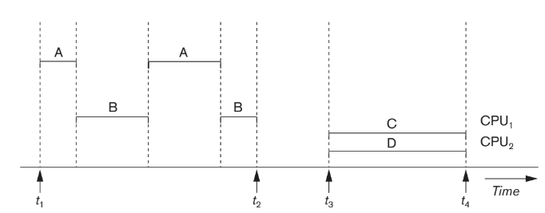
Database Management Systems
Single-User versus Multiuser Systems
Fig 20.1 Interleaved processing versus parallel processing of concurrent transactions

Slide 15
Database Management Systems
Introduction to Transaction Processing Concepts and Theory
Transactions
Transaction: an executing program
Forms logical unit of database processing
Begin and end transaction statements
Specify transaction boundaries
Read-only transaction
Read-write transaction

Slide 16
Database Management Systems
Introduction to Transaction Processing Concepts and Theory
Read and Write Operations
read_item(X)
Reads a database item named X into a program variable named X
Process includes finding the address of the disk block, and copying it into a buffer in the main memory.Copy item X from the buffer to the program variable named X
write_item(X)
Writes the value of program variable X into the database item named X
Process includes finding the address of the disk block, copying it into a buffer in the main memory.Copy item X from the program variable named X into its correct location in the buffer, and storing the updated disk block back to disk

Slide 17
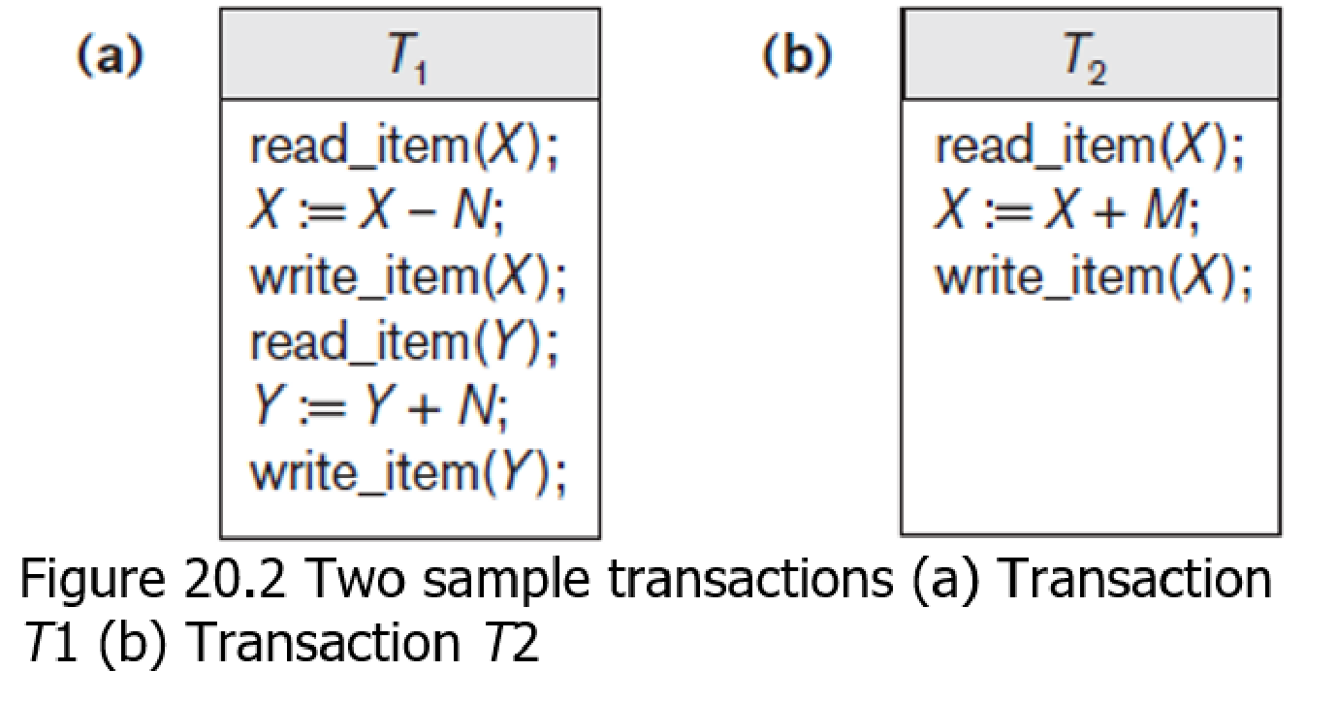
Database Management Systems
Introduction to Transaction Processing Concepts and Theory
Read and Write Operations (cont’d.)
Read set of a transaction
Set of all items read
Write set of a transaction
Set of all items written

Slide 18
Database Management Systems
Introduction to Transaction Processing Concepts and Theory
DBMS Buffers
DBMS will maintain several main memory data buffers in the database cache
When buffers are occupied, a buffer replacement policy is used to choose
which buffer will be replaced
Example policy: least recently used

Slide 19
Database Management Systems
Introduction to Transaction Processing Concepts and Theory
Concurrency Control:
Transactions submitted by various users may execute concurrently
Access and update the same database items
Some form of concurrency control is needed
The lost update problem:
Occurs when two transactions that access the same database items
have operations interleaved
Results in incorrect value of some database items

Slide 20
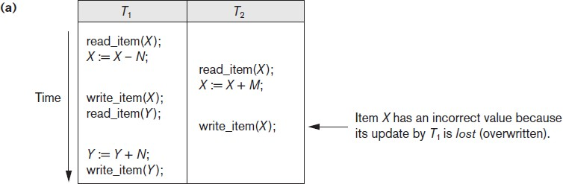
Database Management Systems
Introduction to Transaction Processing Concepts and Theory
The Lost Update Problem:
Figure 20.3 Some problems that occur when concurrent execution is uncontrolled
(a) The lost update
problem

Slide 21
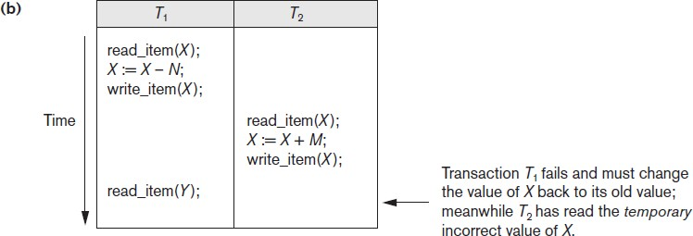
Database Management Systems
Introduction to Transaction Processing Concepts and Theory
The Temporary Update(or Dirty Read) Problem:
This problem occurs when one transaction updates a database item and then
the transaction fails for some reason

Slide 22
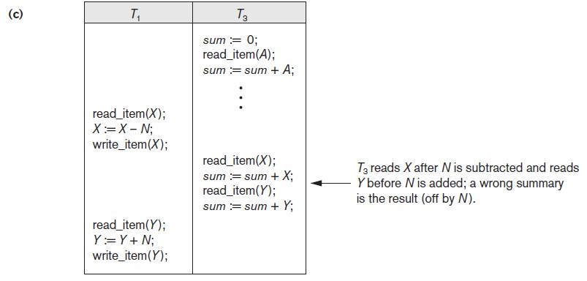
Database Management Systems
Introduction to Transaction Processing Concepts and Theory
The Incorrect Summary Problem:
If one transaction is calculating an aggregate summary function on a number of database items while other transactions are updating some of these items, the aggregate function may calculate some values before they are updated and others after they are updated.
Figure 20.3 (cont’d.) Some problems that occur when concurrent execution is uncontrolled (c) The incorrect summary problem

Slide 23
Database Management Systems
Introduction to Transaction Processing Concepts and Theory
The Unrepeatable Read Problem
A transaction T reads the same item twice and the item is changed by another transaction T′ between the two reads. Hence, T receives different values for its two reads of the same item

Slide 24
Database Management Systems
Introduction to Transaction Processing Concepts and Theory
20.2 Transaction and System Concepts
System must keep track of when each transaction starts, terminates,
commits, and/or aborts
BEGIN_TRANSACTION
READ or WRITE
END_TRANSACTION
COMMIT_TRANSACTION
ROLLBACK (or ABORT)

Slide 25
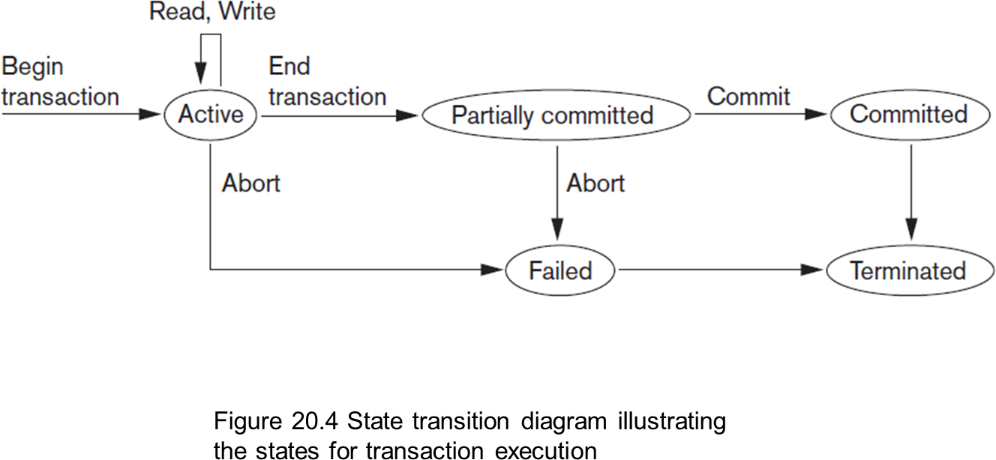
Database Management Systems
Introduction to Transaction Processing Concepts and Theory
Transaction and System Concepts (cont’d.)

Slide 26
Database Management Systems
Introduction to Transaction Processing Concepts and Theory
The System Log
System log keeps track of transaction operations
Sequential, append-only file
Not affected by failure (except disk or catastrophic failure)
Log buffer
Main memory buffer
When full, appended to end of log file on disk
Log file is backed up periodically
Undo and redo operations based on log possible

Slide 27
Database Management Systems
Introduction to Transaction Processing Concepts and Theory
Log Records
T -> Transaction id
[start_transaction, T]. Indicates that transaction T has started execution.
[write_item, T, X, old_value, new_value]. Indicates that transaction T has changed the value of database item X from old_value to new_value.
[read_item, T, X]. Indicates that transaction T has read the value of database item X.
[commit, T]. Indicates that transaction T has completed successfully and affirms that its effect can be committed (recorded permanently) to the database.
[abort, T]. Indicates that transaction T has been aborted.

Slide 28
Database Management Systems
Introduction to Transaction Processing Concepts and Theory
20.3 Desirable Properties of Transactions
ACID properties
Atomicity
Transaction performed in its entirety or not at all
Consistency preservation
Takes database from one consistent state to another
Isolation
Not interfered with by other transactions
Durability or permanency
Changes must persist in the database

Slide 29
Database Management Systems
Introduction to Transaction Processing Concepts and Theory
20.4 Characterizing Schedules Based on Recoverability
Schedule or history
Order of execution of operations from all transactions
Operations from different transactions can be interleaved in
the schedule
Total ordering of operations in a schedule
For any two operations in the schedule, one must occur before the other

Slide 30
Database Management Systems
Introduction to Transaction Processing Concepts and Theory
Characterizing Schedules Based on Recoverability (cont’d.)
Two conflicting operations in a schedule
Operations belong to different transactions
Operations access the same item X
At least one of the operations is a write_item(X)
Two operations conflict if changing their order results in a different
outcome
Read-write conflict
Write-write conflict

Slide 31
Database Management Systems
Introduction to Transaction Processing Concepts and Theory
Characterizing Schedules Based on Recoverability (cont’d.)
“Recoverable schedules”
No committed transaction ever needs to be rolled back.
Recovery is possible
Nonrecoverable schedules should not be permitted by the DBMS
Uncommitted transaction may need to be rolled back
Cascading rollback may occur in some recoverable schedules

Slide 32
Database Management Systems
Introduction to Transaction Processing Concepts and Theory
Characterizing Schedules Based on Recoverability (cont’d.)
Cascadeless schedule
Reads only items that were written by committed
transactions.
Avoids cascading rollback
Strict schedule
Transactions can neither read nor write an item X until the
last transaction that wrote X has committed or aborted
Simpler recovery process
Restore the before image(old value)D

Slide 33
Database Management Systems
Introduction to Transaction Processing Concepts and Theory
20.5 Characterizing Schedules Based on Serializability
Serializable schedules
Always considered to be correct when concurrent
transactions are executing
Places simultaneous transactions in series
Transaction T₁ before T₂, or vice versa

Slide 34
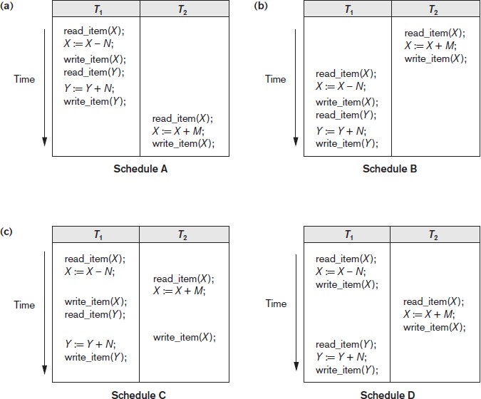
Database Management Systems
Introduction to Transaction Processing Concepts and Theory
Figure 20.5 Examples of serial and nonserial schedules involving transactions T1 and T2 (a) Serial schedule A: T1 followed by T2 (b) Serial schedule B: T2 followed by T1 (c) Two nonserial schedules C and D with interleaving of operations

Slide 35
Database Management Systems
Introduction to Transaction Processing Concepts and Theory
Characterizing Schedules Based on Serializability (cont’d.)
Problem with serial schedules
Limit concurrency by prohibiting interleaving of operations
Unacceptable in practice
Solution: determine which schedules are equivalent to a serial
schedule and allow those to occur
Serializable schedule of n transactions
Equivalent to some serial schedule of same n transactions

Slide 36
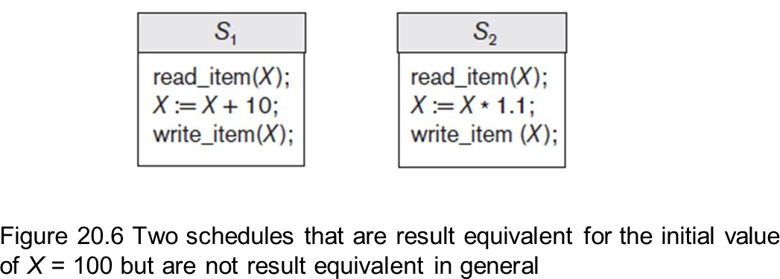
Database Management Systems
Introduction to Transaction Processing Concepts and Theory
Characterizing Schedules Based on Serializability (cont’d.)
Result equivalent
schedules
Produce the same final state of the database
May be accidental
Cannot be used alone to define equivalence of schedules

Slide 37
Database Management Systems
Introduction to Transaction Processing Concepts and Theory
Characterizing Schedules Based on Serializability (cont’d.)
Conflict equivalence of two schedules.
Relative order of any two conflicting operations is the same in bothschedules
If two conflicting operations are applied in different orders in two schedules, the effect can be different on the database or on the transactions in the schedule, and hence the schedules are not conflict equivalent.
Serializable schedules
Schedule S is serializable if it is conflict equivalent to some serial schedule S’.

Slide 38
Database Management Systems
Introduction to Transaction Processing Concepts and Theory
Characterizing Schedules Based on Serializability (cont’d.)
Testing for serializability of a schedule:
1. For each transaction Ti participating in schedule S, create a node labeled Ti in the precedence graph.
2. For each case in S where Tj executes a read_item(X) after Ti executes a write_item(X), create an edge (Ti → Tj) in the precedence graph.
3. For each case in S where Tj executes a write_item(X) after Ti executes a read_item(X), create an edge (Ti → Tj) in the precedence graph.
4. For each case in S where Tj executes a write_item(X) after Ti executes a write_item(X), create an edge (Ti → Tj) in the precedence graph.
5. The schedule S is serializable if and only if the precedence graph has no cycles.
Algorithm 20.1 Testing conflict serializability of a schedule S

Slide 39
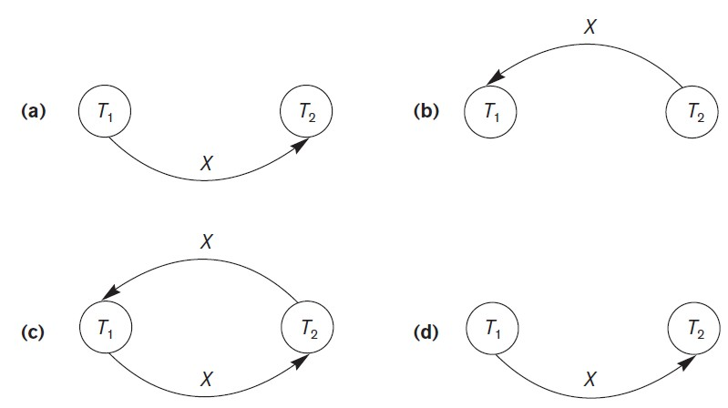
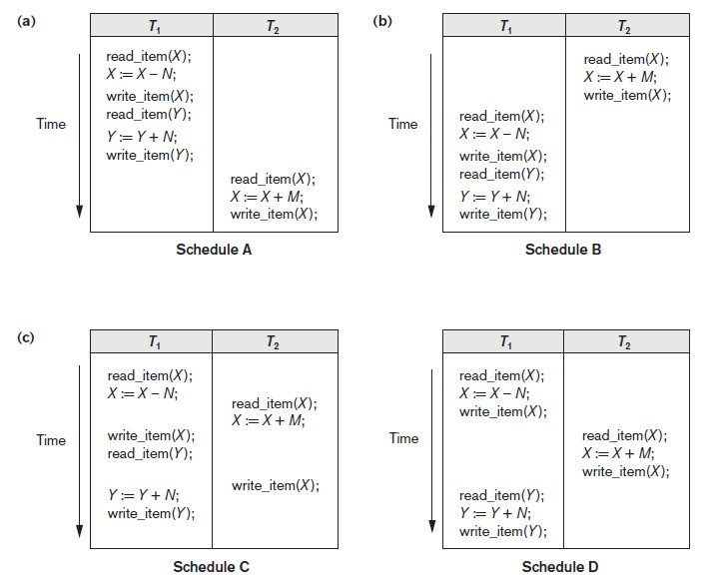
Database Management Systems
Introduction to Transaction Processing Concepts and Theory
Figure 20.7 Constructing the precedence graphs for schedules A to D from Figure 20.5 to test for conflict serializability (a) Precedence graph for serial schedule A (b) Precedence graph for serial schedule B (c) Precedence graph for schedule C (not serializable) (d) Precedence graph for schedule D (serializable, equivalent to schedule A)

Slide 40
Database Management Systems
Introduction to Transaction Processing Concepts and Theory
How Serializability is Used for Concurrency Control
Being serializable is different from being serial
Serializable schedule gives benefit of concurrent execution
Without giving up any correctness
Difficult to test for serializability in practice
Factors such as system load, time of transaction submission, and process
priority affect ordering of operations
DBMS enforces protocols
Set of rules to ensure serializability

Slide 41
Database Management Systems
Introduction to Transaction Processing Concepts and Theory
View Equivalence and View Serializability
View equivalence of two schedules
As long as each read operation of a transaction reads the result of the same write operation in both schedules, the write operations of each transaction must produce the same results
Read operations are hence said to see the same view in both schedules.
View serializable schedule
View equivalent to a serial schedule

Slide 42
Database Management Systems
Introduction to Transaction Processing Concepts and Theory
20.6 Transaction Support in SQL
No explicit Begin_Transaction statement
Every transaction must have an explicit end statement
COMMIT
ROLLBACK
Access mode is READ ONLY or READ WRITE
Diagnostic area size option
Diagnostic size n, Integer value indicating number of conditions held simultaneously in the diagnostic area.(Conditions-> feedback information on the n most recently executed SQL statement.)

Slide 43
Database Management Systems
Commit , Rollback and Savepoint
Dept of Computer Science and Engineering
Prof. Bhargavi M & Prof. Vidhyashree DM

Slide 44
Database Management Systems
SQL Transactions
SQL Transaction Control Language (TCL) commands are used to manage database transaction.
SQL transaction command use with DML statement for INSERT, UPDATE and DELETE.
DML statement are store into SQL buffer until you execute Transaction commands.
Once you execute transaction commands its store permanent to a database.

Slide 45
Database Management Systems
Begin and End
Begin statement will indicate start of the transaction and end transaction will indicate end of transaction
Syntax :
begin
statements
end transaction;

Slide 46
Database Management Systems
SQL COMMIT
SQL COMMIT command save new changes store into database.
Syntax :
Commit ;

Slide 47
Database Management Systems
SAVEPOINT
SQL SAVEPOINT command create new save point. SAVEPOINT command save the current point with the unique name in the processing of a transaction.
Syntax:
SAVEPOINT savepoint_name;

Slide 48
Database Management Systems
SQL ROLLBACK
SQL ROLLBACK command execute at the end of current transaction and undo/undone any changes made since the begin transaction.
Syntax :
ROLLBACK [To SAVEPOINT_NAME];

Slide 49
THANK YOU
Prof. Bhargavi M & Prof. Vidhyashree DM
Department of Computer Science and Engineering

Slide 50
THANK YOU
Prof. Bhargavi M & Prof. Vidhyashree DM
Department of Computer Science and Engineering

Slide 51

Database Management Systems
Introduction to protocols for Concurrency Control in Databases
Prof. Bhargavi M & Prof. Vidhyashree DM
Department of Computer Science and Engineering

Slide 52
Database Management Systems Database Concurrency Control
Purpose of Concurrency Control
To enforce Isolation (through mutual exclusion) among conflicting transactions.
To preserve database consistency through consistency preserving execution of transactions.
To resolve read-write and write-write conflicts.
Example:
In concurrent execution environment if T1 conflicts with T2 over a data item A, then the existing concurrency control decides if T1 or T2 should get the A and if the other transaction is rolled-back or waits.

Slide 53
Database Management Systems Two-Phase Locking Techniques
Locking is an operation which secures
permission to Read
permission to Write a data item for a transaction.
Example:
Lock (X). Data item X is locked in behalf of the requesting Transaction.
Unlocking is an operation which removes these permissions from the
data item.
Example:
Unlock (X): Data item X is made available to all other transactions.
Lock and Unlock are Atomic operations.

Slide 54
Database Management Systems
Two- Phase Locking system
Binary Locking
A binary lock can have two states or values: locked and unlocked
(or 1 and 0, for simplicity)
A distinct lock is associated with each database item X.
If the value of the lock on X is 1, item X cannot be accessed by a database operation that requests the item.
If the value of the lock on X is 0, the item can be accessed when requested, and the lock value is changed to 1
Database requires that all transactions should be well-formed.
A transaction is well-formed if:
It must lock the data item before it reads or writes to it.
It must not lock an already locked data items and it must not
try to unlock a free data item.

Slide 55
Database Management Systems
Two-Phase Locking Techniques: Essential components
- Lock Manager
Managing locks on data items.
Lock Table
Lock manager uses it to store the identity of a transaction locking a data item, the data item, lock mode and pointer to the next data item locked.
One simple way to implement a lock table is through linked list.

Slide 56
Database Management Systems
Two-Phase Locking Techniques: Essential components
lock_item(X):
The following code performs the lock operation:
B: if LOCK (X) = 0 (*item is unlocked*) then LOCK (X) ← 1 (*lock the item*) else
begin
wait (until lock (X) = 0
And the lock manager wakes up the transaction); goto B
end;

Slide 57
Database Management Systems
Two-Phase Locking Techniques: Essential components
unlock_item(X):
The following code performs the unlock operation:
LOCK (X) ← 0 (*unlock the item*) if any transactions are waiting
then wake up one of the waiting transactions;

Slide 58
Database Management Systems
Two-Phase Locking Techniques: Essential components
Two locks modes:
Shared /Exclusive Locks (READ/WRITE LOCKS):
shared (read)
exclusive (write).
Shared Mode: Read lock (X)
More than one transaction can apply share lock on X for reading its
value but no write lock can be applied on X by any other transaction.
Exclusive Mode: Write lock (X)
Only one write lock on X can exist at any time and no shared
lock can be applied by any other transaction on X.
-
-
- UNLOCK MODE.

Slide 59
Database Management Systems
Two-Phase Locking Techniques: Essential components
Lock Table
keep track of the number of transactions that hold a shared (read) lock on
an item in the lock table,
as well as a list of transaction ids that hold a shared lock.
Each record in the lock table will have four fields:
<Data_item_name, LOCK, No_of_reads, Locking_transaction(s)>.
The system needs to maintain lock records only for locked items in the lock table. (The value (state) of LOCK is either read-locked or write-locked, suitably coded.)
If LOCK(X) = write-locked, the value of locking_transaction(s) is a single transaction that holds the exclusive (write) lock on X.
If LOCK(X)=read-locked, the value of locking transaction(s) is a list of one
or more transactions that hold the shared (read) lock on X.

Slide 60
Database Management Systems
Two-Phase Locking Techniques: Essential components
Lock Conversion
Lock upgrade: existing read lock to write lock
if Ti has a read-lock (X) and Tj has no read-lock (X) (i ≠ j)
then convert read-lock (X) to write-lock (X)
else force Ti to wait until Tj unlocks X
Lock downgrade: existing write lock to read lock
Ti has a write-lock (X) (*no transaction can have any lock
on X*)
convert write-lock (X) to read-lock (X)

Slide 61
Database Management Systems
Two-Phase Locking Techniques: The algorithm Two Phases:
Locking (Growing)
Unlocking (Shrinking).
Locking (Growing) Phase:
A transaction applies locks (read or write) on desired data
items one at a time.
Unlocking (Shrinking) Phase:
A transaction unlocks its locked data items one at a time.
Requirement:
For a transaction these two phases must be mutually exclusively, that is, during locking phase unlocking phase must not start and during unlocking phase locking phase must not begin.

Slide 62



























































































































































Database Management Systems
Two-Phase Locking Techniques: The algorithm
Other variations of 2 phase locking:
Basic:
Transaction locks data items incrementally. This may cause deadlock
which is dealt with.
Conservative:
Prevents deadlock by locking all desired data items before transaction begins
execution.
Strict 2PL:
A transaction T does not release any of its exclusive (write) locks until after it
commits or aborts.
Rigourous 2PL:
A transaction T does not release any of its locks (exclusive or shared) until
after it commits or aborts, and so it is easier to implement
than strict 2PL.

Slide 63
THANK YOU
Prof. Bhargavi M & Prof. Vidhyashree DM
Department of Computer Science and Engineering

Slide 64
Database Management Systems
Deadlock Detection and Prevention
Prof. Bhargavi M & Prof. Vidhyashree DM
Department of Computer Science and Engineering

Slide 65
Database Management Systems Dealing with Deadlock and Starvation
CONCURRENCY CONTROL SUBSYSTEM
Responsible for generating the read_lock and write_lock request
For example, suppose the system is to enforce the strict 2PL protocol.
Then, whenever transaction T issues a read_item(X), the system calls the read_lock(X) operation on behalf of T.
If the state of LOCK(X) is write_locked by some other transaction T′, the system places T in the waiting queue for item X;
otherwise, it grants the read_lock(X) request and permits the read_item(X)
operation of T to execute.
After each action, the system must update its lock table appropriately.
Locking is generally considered to have a high overhead, because every read or write operation is preceded by a system locking request.
The use of locks can also cause two additional problems: deadlock and starvation

Slide 66
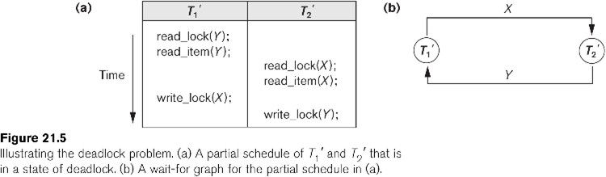
Database Management Systems Dealing with Deadlock and Starvation

Slide 67


Database Management Systems Dealing with Deadlock and Starvation
Deadlock prevention:
A transaction locks all data items it refers to before it begins execution.
This way of locking prevents deadlock since a transaction never waits for a data item.
- The conservative two-phase locking uses this approach.
- limits concurrency
Transaction timestamp TS(T′), which is a unique identifier assigned to each transaction.
The timestamps are typically based on the order in which transactions are
started; hence, if transaction T1 starts before transaction T2, then TS(T1) < TS(T2).
Notice that the older transaction (which starts first) has the smaller timestamp value.

Slide 68
































Database Management Systems Dealing with Deadlock and Starvation
Two schemes that prevent deadlock are
wait-die
wound-wait.
Suppose that transaction Ti tries to lock an item X but is not able to because X is locked by
some other transaction Tj with a conflicting lock.
The rules followed by these schemes are:
Wait-die. If TS(Ti) < TS(Tj), then (Ti older than Tj) Ti is allowed to wait;
otherwise (Ti younger than Tj) abort Ti (Ti dies) and restart it later with the different timestamp.
Wound-wait. If TS(Ti) < TS(Tj ), then (Ti older than Tj) abort Tj (Ti wounds Tj) and restart it later with the same timestamp; otherwise (Ti younger than Tj
) Ti is allowed to wait.

Slide 69
Database Management Systems Dealing with Deadlock and Starvation
Deadlock detection and resolution:
In this approach, deadlocks are allowed to happen. The scheduler maintains a wait-for-graph for detecting cycle. If a cycle exists, then one transaction involved in the cycle is selected (victim) and rolled-back.
A wait-for-graph is created using the lock table. As soon as a transaction is blocked, it is added to the graph. When a chain like: Ti waits for Tj waits for Tk waits for Ti or Tj occurs, then this creates a cycle.
Timeouts : Another simple scheme to deal with deadlock is the use of timeouts. This method is practical because of its low overhead and simplicity. In this method, if a transaction waits for a period longer than a system-defined timeout period, the system assumes that the transaction may be deadlocked and aborts it—regardless of whether a deadlock actually exists.

Slide 70
Database Management Systems Dealing with Deadlock and Starvation
Starvation
Starvation occurs when a particular transaction consistently waits or restarted
and never gets a chance to proceed further.
In a deadlock resolution it is possible that the same transaction may
consistently be selected as victim and rolled-back.
This limitation is inherent in all priority based scheduling mechanisms.
In Wound-Wait scheme a younger transaction may always be wounded
(aborted) by a long running older transaction which may create starvation.

Slide 71
Database Management Systems Dealing with Deadlock and Starvation
Timestamp
A monotonically increasing variable (integer) indicating the age of an operation or a transaction. A larger timestamp value indicates a more recent event or operation.
Timestamp based algorithm uses timestamp to serialize the
execution of concurrent transactions.

Slide 72
Database Management Systems Timestamp based concurrency control algorithm
Basic Timestamp Ordering
Transaction T issues a write_item(X) operation:
If read_TS(X) > TS(T) or if write_TS(X) > TS(T), then an younger transaction has already read the data item so abort and roll-back T and reject the operation.
If the condition in part (a) does not exist, then execute write_item(X) of T and set write_TS(X) to TS(T).
Transaction T issues a read_item(X) operation:
If write_TS(X) > TS(T), then an younger transaction has already
written to the data item so abort and roll-back T and reject the operation.
If write_TS(X) ≤ TS(T), then execute read_item(X) of T and set read_TS(X) to the larger of TS(T) and the current read_TS(X).

Slide 73
Database Management Systems Timestamp based concurrency control algorithm
Strict Timestamp Ordering
Transaction T issues a write_item(X) operation:
If TS(T) > read_TS(X), then delay T until the transaction T’ that wrote or read X has terminated (committed or aborted).
Transaction T issues a read_item(X) operation:
If TS(T) > write_TS(X), then delay T until the transaction T’ that wrote or read X has terminated (committed or aborted).

Slide 74



Database Management Systems
Timestamp based concurrency control algorithm
Thomas’s Write Rule:
A modification of the basic TO algorithm, known as
Thomas’s write rule, does not enforce conflict serializability, but it rejects fewer write operations by modifying the checks for the write_item(X) operation as follows:
If read_TS(X) > TS(T) then abort and roll-back T and reject the operation.
If write_TS(X) > TS(T), then just ignore the write operation and continue execution. This is because the most recent writes counts in case of two consecutive writes.
If the conditions given in 1 and 2 above do not occur, then execute write_item(X)
of T and set write_TS(X) to TS(T).

Slide 75
THANK YOU
Prof. Bhargavi M & Prof. Vidhyashree DM
Dept. of Computer Science and Engineering

Slide 76

Database Management Systems
Performance, Query Execution Plan, Indexing
Suresh Jamadagni
Department of Computer Science
and Engineering

Slide 77

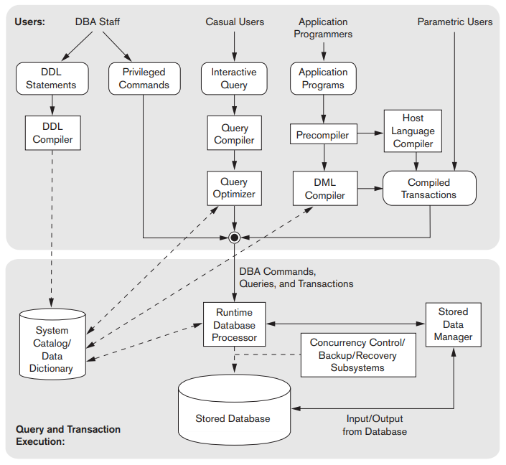













Database Management Systems
Query Optimizer
The query optimizer examines alternative table and index access paths, operator algorithms, join orderings, join methods, parallel execution distribution methods, and so on.
It chooses the execution plan with the lowest estimated cost.
The optimizer calculates this cost based on the estimated usage of resources (such as I/O and CPU time), and memory needed to execute the query.
The estimated query cost is a relative number proportional to the expected elapsed time needed to execute the query with the given execution plan
The goal of cost based optimization is to find the best trade-off between the lowest run time and the least resource utilization

Slide 78
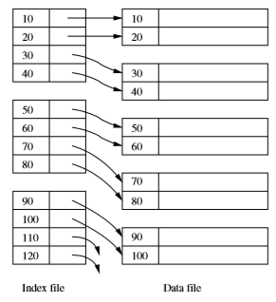
Database Management Systems
Indexes
Index is an auxiliary structure used for faster retrieval of records based on search criteria
A data ﬁle is used to store tuples of a table.
The data ﬁle may have one or more index ﬁles.
Each index ﬁle associates values of the search key with pointers to data-ﬁle records that have that value for the attribute(s) of the search key.
It is common to create a primary index on the primary key of a relation and to create secondary indexes on some of the other attributes.

Slide 79
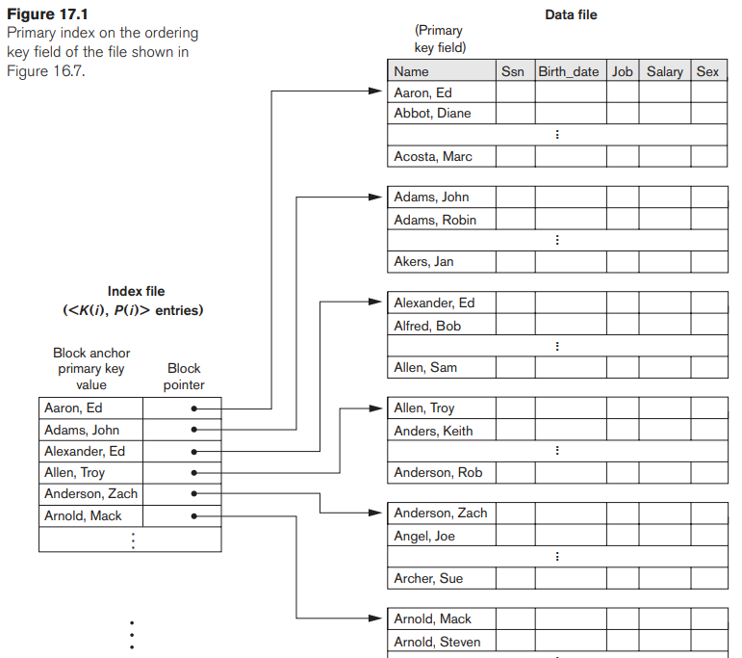
Database Management Systems
Indexes
A primary index is an ordered file whose records are of fixed length with two fields, and it acts like an access structure to efficiently search for and access the data records in a data file.
The first field is of the same data type as the ordering key field—called the primary key—of the data file, and the second field is a pointer to a disk block (a block address).
There is one index entry (or index record) in the index file for each block in the data file.
Each index entry has the value of the primary key field for the first record in a block and a pointer to that block as its two field values

Slide 80
Database Management Systems
Example of cost based optimization
Number of records = 30,000
Record length = 100 bytes
Block size = 1024 bytes
Blocking factor for data record= 1024/100 = 10
Number of blocks required to store 30,000 records = 30000/10 = 3000
A binary search of 3000 blocks will require log₂ 3000 = 12 block access
Length of the ordering key = 9 bytes
Length of the block address field = 6 bytes
Record length of the index file = 9+6 = 15 bytes
Blocking factor for the index file = 1024/15 = 68
Number of entries in the index file = Number of blocks = 3000
Number of blocks required for storing index information = 3000/68 = 45
A binary search on the index file will require log₂ 45 = 6 block access
To retrieve data from the data file will require 1 additional block access for a total of 6 + 1 = 7 block accesses

Slide 81
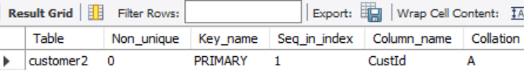
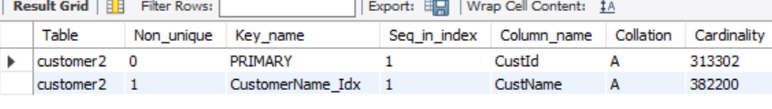
Database Management Systems
DDL for creating Indexes
Create table Customer2 (CustId int not null,
CustName varchar(50) not null,
Address varchar(50) not null,
City varchar(50) not null,
State varchar(50) not null,
PostalCode varchar(50) not null,
primary key (custid));
show index from customer2;
create index CustomerName_Idx on customer2(CustName);
show index from customer2;

Slide 82
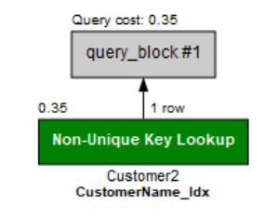
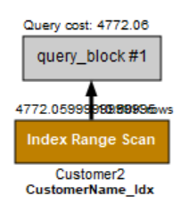
Database Management Systems
Query execution plan
select * from Customer2 where CustName = '829869ABC' ;
select * from Customer2 where CustName like '95%ABC' ;

Slide 83
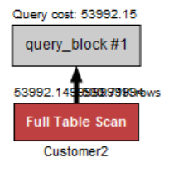
Database Management Systems
Query execution plan
select * from Customer2 where City = 'Bengaluru' ;
Execution plans for SQL statements have a significant impact on the overall performance of a database system.
The optimizer relies on object statistics (e.g., number of rows, distribution of column values, etc.) and system statistics (e.g., I/O bandwidth of the storage subsystem).
The optimality of the final execution plan depends primarily on the accuracy of the statistics fed into the cost model.
To update the object statistics, users can execute the analyze command
analyze table <table name> update histogram on <column name>;
Example: analyze table customer2 update histogram on CustName;

Slide 84
THANK YOU
Suresh Jamadagni
Department of Computer Science and Engineering
sureshjamadagni@pes.edu

Slide 85
Database Management Systems
NoSQL Databases
Prof. Bhargavi M & Prof. Vidhyashree DM
Department of Computer Science
and Engineering

Slide 86

Database Management Systems
Why NoSQL ??
Most features of RDBMS are not required in internet/web-based applications.
Features like structured data storage, powerful query language, data consistency.
Instead, other features are more important for internet/web-based application.
Semi-structured data, high performance, availability, scalability, replication.

Slide 87
Database Management Systems
What do these applications need ??
Google/Bing/Yahoo 🡪Index of documents on the web
Google/Yahoo/Hotmail 🡪 emails
Amazon🡪 Products, Reviews, Ratings, Customers, Addresses
Facebook 🡪 Posts(Videos, Images, etc), Likes and Shares
Twitter 🡪Tweets, Replies, Retweets, Likes.
Flickr, Google 🡪 Photos
Youtube/Netflix 🡪 Videos
News Sites🡪 Articles, comments and replies

Slide 88
Database Management Systems
Emergence of NOSQL
Scenario - 01:
You uploaded a picture to facebook.
Some of your friends see the picture and some do not see it. Is it OK?
You withdrew money from ATM.
Is it OK to see two different balances like your friends are seeing two different views of your “facebook wall”?
Is it better to let some friends view the post or wait till everyone can see the same post?

Slide 89
Database Management Systems
Emergence of NOSQL
Scenario - 02:
You are browsing amazon for buying some item.
Are there more reads or writes?
Are there only text or text and images and videos of advertisements, product usage and user reviews and ratings as well?
Are all the products (say a camera and a mobile phone) having the same attributes?
Are there thousands or millions of – users, products, reviews, ratings, pictures, videos, etc?
Is it OK to shutdown the servers for maintenance?
Some time there are thousands of users and some other time there are millions of users.

Slide 90
Database Management Systems
NOSQL Databases
NoSQL databases emerged when SQL databases could not meet the requirements of new web applications like the ones mentioned earlier.
NoSQL (non-relational) databases have existed since 1960s.
The name NoSQL was given in 1998 (wikipedia).
Emergence of Internet (Increase in volume of data and the need for a better way of managing the data):
Search-indexing, Web based Email, Amazon shopping, Social Network: Facebook, Twitter, Flikr, NetFlix, Youtube, ...

Slide 91
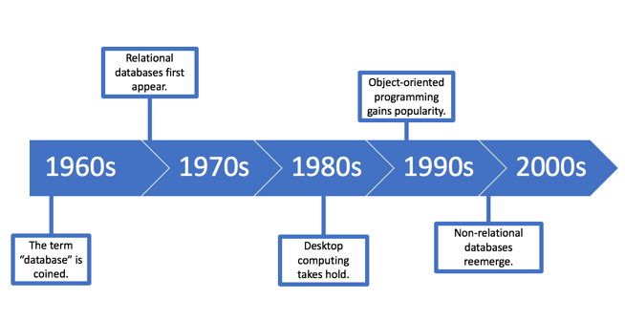




Database Management Systems
NoSQL Databases
NoSQL (not only SQL) is an alternative to traditional relational databases in which data is placed in tables and data schema is carefully designed before the database is built.
NoSQL databases are especially useful for working with large sets of distributed data.
NoSQL is an approach to database design that can accommodate a wide variety of data models, including key-value, document, columnar and graph formats
NoSQL databases are databases that store data in a format other than relational tables

Slide 92


Database Management Systems
NoSQL Databases
NoSQL stands for not only SQL.
SQL stands for relational databases and NOT for SQL (language)
Different applications require different (other than RDBMS) database approaches.
Some NoSQL databases
BigTable by Google (Column-based or Wide Column, Apache Hbase is based on BigTable)
DynamoDB by Amazon (Key-Value store, Voldemort is key-value store)
Cassandra by Facebook (Based on both key-value and column-based. Available as Apache Cassandra)
MongoDB, CouchDB (Document based)
Neo4J Graph database.

Slide 93
Database Management Systems
Characteristics of NoSQL systems
Scalability
From 100s to millions of users/usage/objects.
Adding more servers and databases handles increased users/usage/objects.
Availability
Always on. Imagine life(for customers and companies) without Google / Amazon /FB...
Replication Models
How and Where to store a copy (in case things go wrong, read from the copy)?
Sharding of files (Horizontal partitioning of files)
Dividing rows into many parts and storing in many servers (for faster access).
High Performance Data Access
The dreaded hourglass/spinning wheel… users will run away from slow sites.
hashing or range partitioning on object keys
Notes:
Scalability: In NOSQL systems, horizontal scalability is generally used, where the distributed system is expanded by adding more nodes for data storage and processing as the volume of data grows.
Availability, Replication and Eventual Consistency: Data is replicated over two or more nodes in a transparent manner so that if one node fails, the data is still available on other nodes. Replication improves data availability and can also improve read performance, because read requests can often be serviced from any of the replicated data nodes.
Sharding of Files: Horizontal partitioning of the file records is often employed in NOSQL systems. This serves to distribute the load of accessing the file records to multiple nodes. The combination of sharding the file records and replicating the shards works in tandem to improve load balancing as well as data availability.
High-Performance Data Access: In many NoSQL applications, it is necessary to find individual records from among the millions of data records or objects in a file. To achieve this, most systems use one of two techniques: hashing or range partitioning on object keys. The majority of accesses to an object will be by providing the key value rather than by using complex query conditions.

Slide 94
Database Management Systems
Characteristics of NoSQL systems
Not requiring a Schema
Mostly accessed by keys.
Semi-structured data described by JSON or XML
Less powerful Query Language
No support for SQL (or limited SQL support)
Access for CRUD through API
Versioning
Storing multiple version of data with time stamps.
Notes:
Not Requiring a Schema: The flexibility of not requiring a schema is achieved in many NoSQL systems by allowing semi-structured, self describing data.
Less Powerful Query Languages: Many applications that use NoSQL systems may not require a powerful query language such as SQL because search (read) queries in these systems often locate single objects in a single file based on their object keys.
Versioning: Some NoSQL systems provide storage of multiple versions of the data items, with the timestamps of when the data version was created

Slide 95










Database Management Systems
Types of NoSQL Databases
Document databases store data in documents similar to JSON (JavaScript Object Notation) objects. Each document contains pairs of fields and values. The values can typically be a variety of types including things like strings, numbers, booleans, arrays, or objects.
Key-value databases are a simpler type of database where each item contains keys and values.
Wide-column stores store data in tables, rows, and dynamic columns.
Graph databases store data in nodes and edges. Nodes typically store information about people, places, and things, while edges store information about the relationships between the nodes.

Slide 96

Database Management Systems
Datamodel and the associated Databases
Key-Value:
BerkleyDB
LevelDB
Memcached
Redis
Riak
Document:
CouchDB
MongoDB
Raven
TerraStore
Columnar:
Cassandra
Amazon SimpleDB
Hbase
Hypertable
Graph:
FlockDB
Neo4J
Orient
Infinite Graph

Slide 97
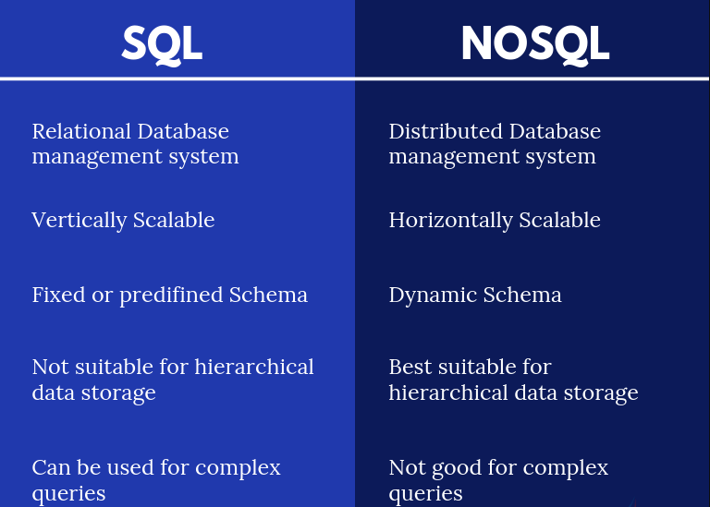








Database Management Systems
Differences between RDBMS and NoSQL Databases
Notes:
Difference between nosql and RDBMS with an example: https://www.mongodb.com/nosql-explained

Slide 98
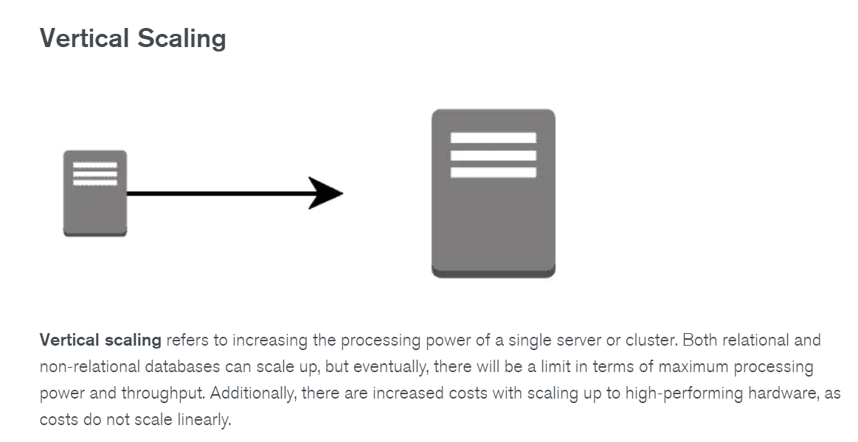
Database Management Systems
Differences between RDBMS and NoSQL Databases
Notes:
Difference between nosql and RDBMS with an example: https://www.mongodb.com/nosql-explained

Slide 99
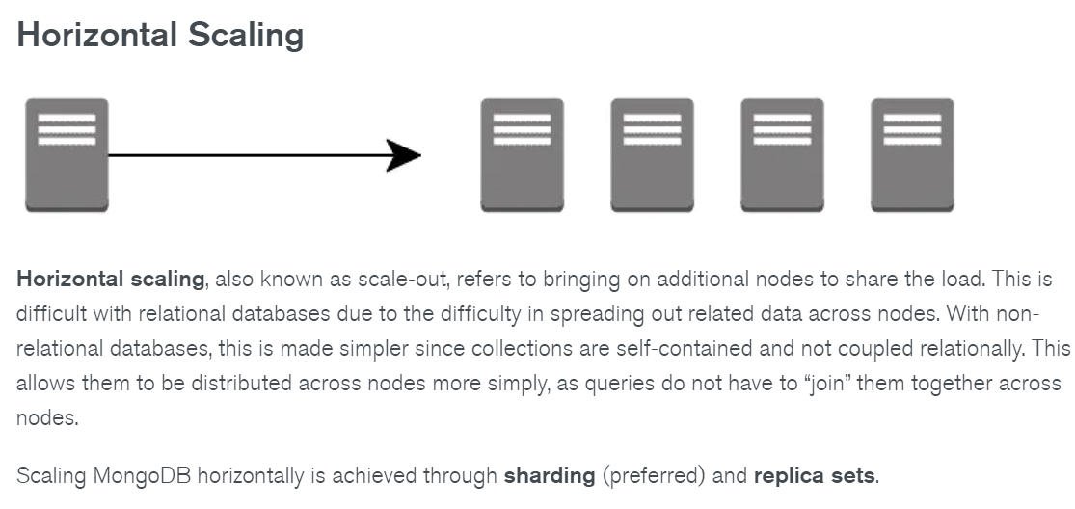




Database Management Systems
Differences between RDBMS and NoSQL Databases
Notes:
Difference between nosql and RDBMS with an example: https://www.mongodb.com/nosql-explained

Slide 100
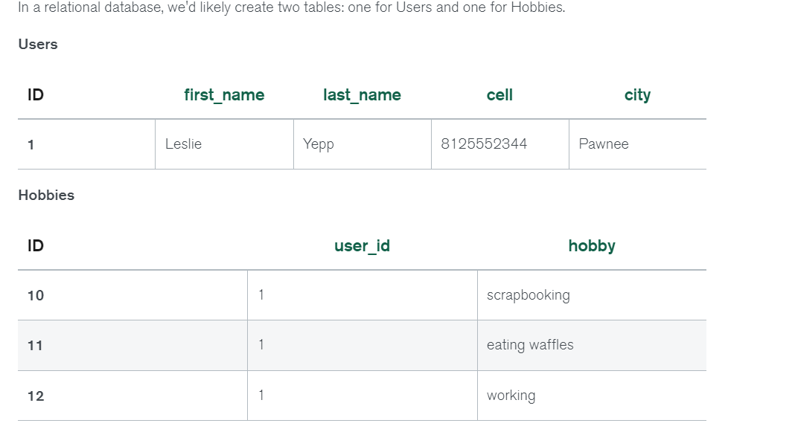
Database Management Systems
Differences between RDBMS and NoSQL Databases
In order to retrieve all of the information about a user and their hobbies, a single document can be retrieved from the database. No joins are required, resulting in faster queries in MongoDB.
{ "_id": 1,
"first_name": "Leslie",
"last_name": "Yepp",
"cell": "8125552344",
"city": "Pawnee",
"hobbies": ["scrapbooking", "eating waffles", "working"] }
Notes:
Difference between nosql and RDBMS with an example: https://www.mongodb.com/nosql-explained

Slide 101
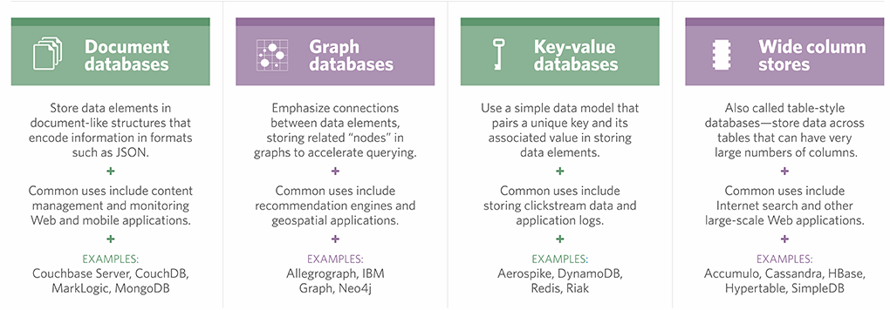
Database Management Systems
Categories of NoSQL Databases

Slide 102
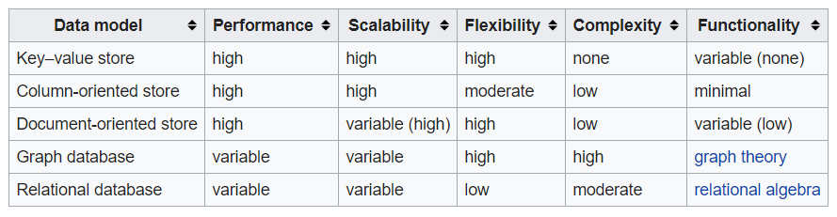
Database Management Systems
Comparison of Features of NoSQL Databases

Slide 103
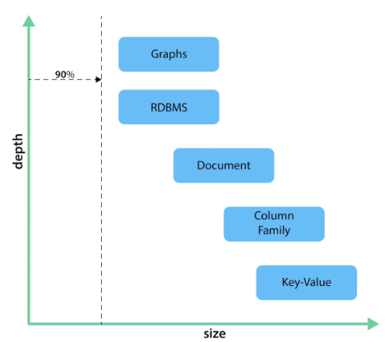
Database Management Systems
When to use which database
Calculating average income
- Use a Relational database.
Building a shopping cart
- Use a key-value Store.
Storing structured product information
- Use a document data store
Describing how a user got from point A to point B
- Use a graph database.
Database type stacks wrt measuring depth and size
Notes:
Reference for the diagram: https://neo4j.com/developer/graph-db-vs-nosql/

Slide 104
THANK YOU
Department of Computer Science and Engineering

Slide 105
DATABASE
TECHNOLOGIES
NoSQL Databases - DocumentDB
Mahitha G
Department of Computer Science
and Engineering

Slide 106
DATABASE TECHNOLOGIES
Document Database - MongoDB
Mahitha G
Department of Computer Science and Engineering

Slide 107
DATABASE TECHNOLOGIES
MongoDB - Hu(mongo)us
MongoDB was designed as a scalable database - the name Mongo comes from “humongous”- with performance and easy data access as core design goals.
It is a document database, which allows you to store objects nested to whichever depth you’d like and you can query that nested data in an ad-hoc fashion.
It enforces no schema, so documents can contain fields or types that no other document in the collection contains
MongoDB hits a sweet spot between the powerful query ability of a relational database and the distributed nature of other databases
Mongo is a JSON document database. A Mongo document is similar to a relational table row without a schema, whose values can nest to an arbitrary depth

Slide 108
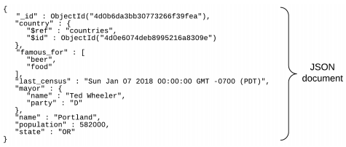
DATABASE TECHNOLOGIES
MongoDB
Document-Oriented storage
Full Index Support
Replication & High Availability
Auto-Sharding
Querying
Fast In-Place Updates
Map/Reduce functionality

Slide 109
DATABASE TECHNOLOGIES
MongoDB
MongoDB stores data as documents.
A document in MongoDB consists of field-value pairs.
Documents are organized in a structure called collection.
To make an analogy, document can be considered as a row in a table and collection can be considered as an entire table.

Slide 110




DATABASE TECHNOLOGIES
MongoDB – Who uses????
Notes:
https://www.mongodb.com/who-uses-mongodb

Slide 111
DATABASE TECHNOLOGIES
MongoDB use case
SEGA uses MongoDB for handling 11 million in-game accounts.
Cisco moved its VSRM (video session and research manager) platform to Couchbase to achieve greater scalability.
Aer Lingus uses MongoDB with Studio 3T to handle ticketing and internal apps.
Built on MongoDB, The Weather Channel’s iOS and Android apps deliver weather alerts to 40 million users in real-time.
Notes:
https://studio3t.com/knowledge-base/articles/nosql-database-types/#the-tldr-history-of-nosql

Slide 112



















































DATABASE TECHNOLOGIES
MongoDB – Data model
MongoDB provides two types of data models: —
Embedded data model
Normalized data model.
Based on the requirement, use either of the models

Slide 113
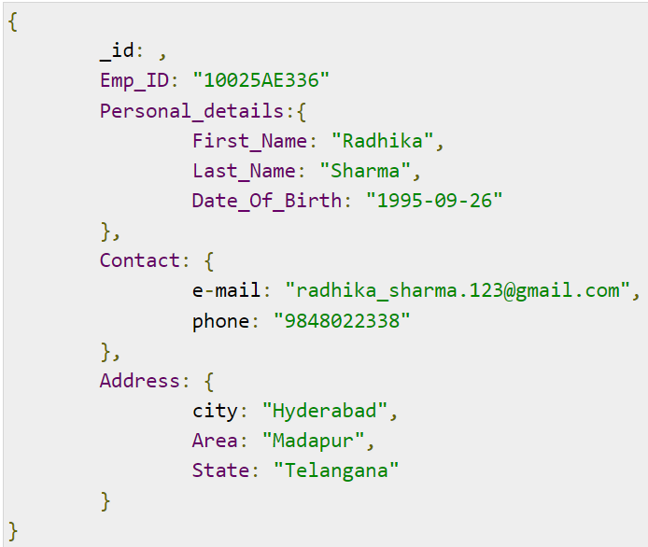
DATABASE TECHNOLOGIES
MongoDB – Data model
Embedded Data Model:
This model, can embed or have all the related data in a single document, it is also known as de-normalized data model.
For example, the details of employees in three different documents namely, Personal_details, Contact and, Address, can be embed in a single one

Slide 114
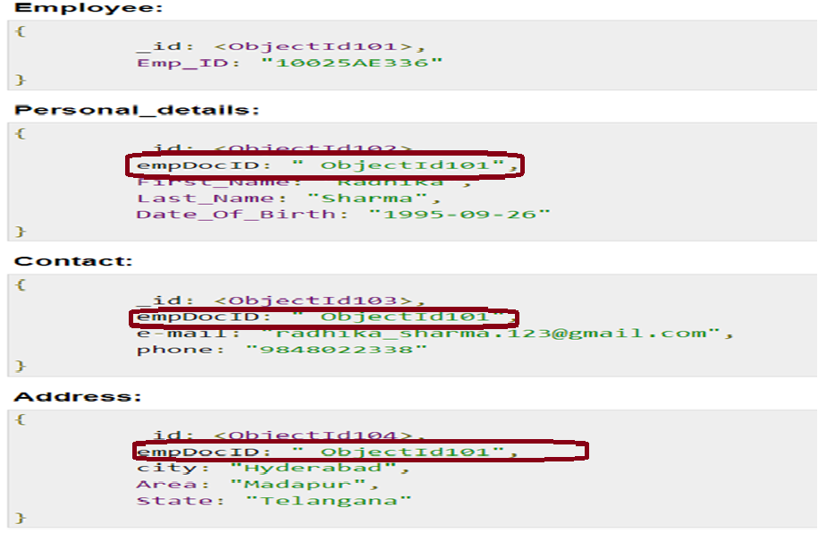






DATABASE TECHNOLOGIES
MongoDB – Data model
Normalized Data Model:
This model, can refer the sub documents in the original document, using references.
For example, re-write the previous document in the normalized model as:

Slide 115






DATABASE TECHNOLOGIES
MongoDB - Commands
Use Command
The command will create a new database if it doesn't exist, else returns the existing database (connects to the new database created)
Format: use database_name
Example: use testdb
//testdb is the current db on which you can work

Slide 116




DATABASE TECHNOLOGIES
MongoDB - Commands
db Command: To check which database you are connected
Example: db
Testdb
//output – name of the db displayed.
Command to list all databases
show dbs
//testdb not shown here:
// database should have atleast one document in it to be displayed

Slide 117






DATABASE TECHNOLOGIES
MongoDB - Commands
dropdatabase Command: To drop the current database
Format: db.dropDatabse()
Example: db.dropDatabase ()
// the current database is dropped ie Testdb is dropped

Slide 118
DATABASE TECHNOLOGIES
MongoDB - Datatypes
Some of the Datatypes supported
String
Integer
Boolean
Double
Arrays
Timestamp
Object
Symbol
Date
Code
Binary Data
Regular Expression
Null
Notes:
https://www.tutorialspoint.com/mongodb/mongodb_datatype.htm

Slide 119





DATABASE TECHNOLOGIES
MongoDB - Commands
Collections: Each database has a collection. MongoDB stores documents in collections. Collections are analogous to tables in relational databases
db.createCollection is used to create collection.
Format: db.createCollection(name, options)
name indicates name of the collection to be created.
options is a document and is used to specify configuration of collection.
Options parameter is optional
Example: db.createCollection(“myTest”) // myTest is the collection created under testdb

Slide 120




DATABASE TECHNOLOGIES
MongoDB
To list all collections in the database:
show collections
//will list out all the collections in the database
To create a collection and add a document into the collection:
db.sample.insert({“Name”:”Rama”})
//creates a new collection by name “sample” and inserts a document into it

Slide 121
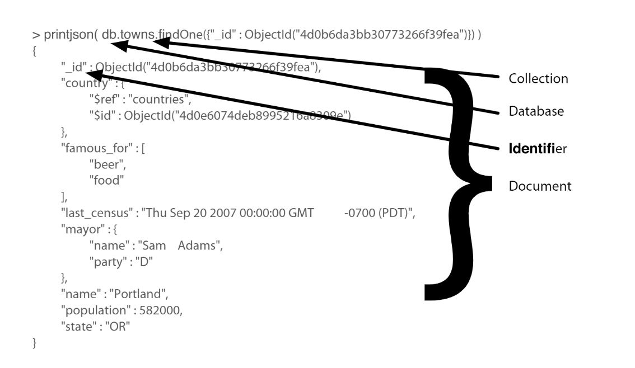




















DATABASE TECHNOLOGIES
Mongodb document printed as JSON

Slide 122
DATABASE TECHNOLOGIES
MongoDB
To drop a collection
Format: db.Collection_name.drop()
Example: db.sample.drop()

Slide 123







DATABASE TECHNOLOGIES
MongoDB
Two options to insert a document into a collection
Insert one document at a time
Insert multiple documents through an array
Format: db.collection_name.insert(document) // insert one document @ a time
db.collection_name.insert([comma separated documents]) //insert multiple
Example: db.sample.insert(“Name” : “Rama”)
db.sample.insert(“Name”:”Rama”, ”Name”:”John”,”Name”:”Praveen”)
// other variations: db.collection.insertone(), db.collection.insertMany()……
// if sample collection does not exist, it creates and then add’s the document.
// if _id parameter is not specified – mongo adds _id which is a unique identifier
Notes:
https://www.tutorialspoint.com/mongodb/mongodb_insert_document.htm

Slide 124

DATABASE TECHNOLOGIES
MongoDB
Find() – method to query documents from a collection
Format: db.collection.find(query, projection)
//displays the documents in unstructured format
Example: db.sample.find()
// displays all documents with all fields
db.sample.find().pretty()
// displays the documents in structured format
Parameter | Type | Description
Query | Document | Optional. Specifies selection filter. To return all documents omit this parameter or pass an empty document ({})
Projection | Document | Optional. Specify the fields to be returned. To return all fields in the matching documents, omit this parameter

Slide 125
















DATABASE TECHNOLOGIES
MongoDB
Query: Display the first document in the collection
db.employee.findone()
//findone() does not support pretty() method
Query: Display the document of employee with empid=2
db.employee.find({“empid”:2})
Query: Display the document related to young employees (age<30)
db.employee.find({“age”:{$lt:”30”}})
lt -> less than
gt -> greater than
lte -> less than or equal to
gte -> greater than or equal to

Slide 126
DATABASE TECHNOLOGIES
MongoDB
Query: Return the employees born after ‘1988-10-10’ from employee collection
db.employee.find( { “birth”: { $gt: new Date('1950-01-01') } } )
Query : Return all the employees who have skilled in mongodb
db.employee.find({“skill”:”mongodb”})
Query: Return all the employees skilled in mongodb and salary of 80000
db.employee.find({“skill”:”mongodb”,”salary”:”80000”})
Query: Return all employees either skilled in mongodb or salary of 80000
db.employee.find({$or:[{“skill”:”mongodb”},{”salary”:”80000”}])
//and -> , or $and [{condition 1},{condition 2}]
//or -> $or:[{condition 1},{condition 2}]

Slide 127

DATABASE TECHNOLOGIES
MongoDB
Query: Return documents where birth is between 1940-01-01 and 1960-01-01
db.employees.find( { birth: { $gt: new Date('1940-01-01'), $lt: new Date('1960-01-01') } } )
Query: Return documents where employees are skilled in “mongodb” and either with salary 80000 or 85000
db.employee.find({“skill”:”mongodb”}, $or:[{”salary”:”80000”}, {”salary”:”85000”}])

Slide 128









DATABASE TECHNOLOGIES
MongoDB
Update values in documents:
Format: db.collection_name.update(selection_criteria, update_value)
Query: update salaries of all employees with skill “mongodb”
db.employee.update({“skill”:”mongodb”},{$set:{“salary”:”1000000”}})
// modifies one document
// to update all
db.employee.update({“skill”:”mongodb”},{$set:{“salary”:”1000000”}}) {multi:true}

Slide 129
DATABASE TECHNOLOGIES
MongoDB
To remove documents from the collection
Format: db.collection_name.remove(selection_criteria,flag)
db.collection_name.remove({}) // removes all documents from the collection
Query: Remove all employees skilled in “mongodb”
db.employee.remove({“skill”:”mongodb”},1}) // removes only one employee
db.employee.remove({“skill”:”mongodb”}}) // removes all employees skilled in mongodb

Slide 130
DATABASE TECHNOLOGIES
MongoDB
To display only necessary data from documents in the collection
Format: db.collection_name.find(selection_criteria, fields required)
db.employee.find({},{“firstname”:1})
//display firstname and object_id of all the employees
{} -> all documents ie no selection criteria
1 -> indicates display firstname (select firstname)
0 -> indicates do not select the field
db.employee.find({},{“firstname”:1,”_id”:0})
//displays only firstname of all the employees

Slide 131
DATABASE TECHNOLOGIES
MongoDB
Add these to the previous query:
.limit(5) -> it displays only first 5 instances
.skip(3) -> skips first 3 instances
.skip(3).limit(5) ->skip first 3 and from there display 5
.sort({“firstname”:1}) -> sorts according to firstname
1 -> ascending order
-1 -> descending order

Slide 132
DATABASE TECHNOLOGIES
MongoDB - Aggregation
Foramt: db.collection_name.aggregate(aggregate_operation)
Query: To check how many male and female employees:
db.employee.aggregate([{$group:_id:”$gender”, Total : “$sum”:1}] )
$sum, $avg, $max, $min
db.collection_name.count() // to know number of documents in the collection

Slide 133
DATABASE TECHNOLOGIES
MongoDB
Limitations:
No referential integrity
High degree of denormalization means updating something in many places instead of one
Lack of predefined schema is a double edged sword
You must have a model in your app
Objects within a collection can be completely inconsistent in their fields

Slide 134
DATABASE TECHNOLOGIES
Difference between Mongodb and RDBMS
RDBMS | MongoDB
It is a relational database. | It is a non-relational and document-oriented database.
Not suitable for hierarchical data storage. | Suitable for hierarchical data storage.
It is vertically scalable i.e increasing RAM. | It is horizontally scalable i.e we can add more servers.
It has a predefined schema. | It has a dynamic schema.
It is quite vulnerable to SQL injection. | It is not affected by SQL injection.
It centers around ACID properties (Atomicity, Consistency, Isolation, and Durability). | It centers around the CAP theorem (Consistency, Availability, and Partition tolerance).
It is row-based. | It is document-based.
It is slower in comparison with MongoDB. | It is almost 100 times faster than RDBMS.
Supports complex joins. | No support for complex joins.
It is column-based. | It is field-based.
It does not provide JavaScript client for querying. | It provides a JavaScript client for querying.
It supports SQL query language only. | It supports JSON query language along with SQL.
Notes:
https://www.geeksforgeeks.org/difference-between-rdbms-and-mongodb/

Slide 135
THANK YOU
Mahitha G
Department of Computer Science and Engineering
mahithag@pes.edu

Slide 136
Database Management Systems
NoSQL – Key Value Store
Prof. Bhargavi M & Prof. Vidhyashree DM
Department of Computer Science
and Engineering

Slide 137
Database Management Systems
Key-Value database
The key-value store is the simplest NoSQL model
There is no query language – but set of operations
The key is a unique identifier associated with a data item and is used to locate this data item rapidly.
The value is the data item itself, and it can have different formats for different key-value storage systems.
Example:
A file system could be considered a key-value store if you think of the file path as the key and the file contents as the value
Notes:
Reference Material : Book : Navathe – section 24.4

Slide 138
Database Management Systems
Examples of Key-Value Stores
Phone Directory
Key :BOB
Value: (123) 456-7890
Artist Info
Key :artist:1:name
Value :JM
IP Forwarding Table
Key : 202.45.12.34
Value : 01:23:36:0f:a2:33
Stock Trading
Key : 234567890
Value :CERN, Sell, 50, 52.78

Slide 139
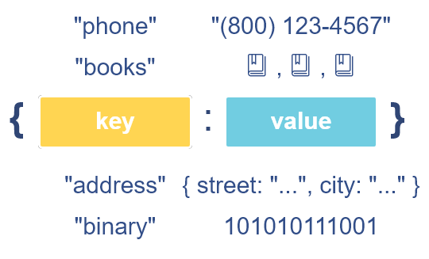
Database Management Systems
Examples of Key-Value Stores

Slide 140
Database Management Systems
Key Value Store - Usecases
Storing Session Information
User Profiles, preferences
Shopping Cart Data
Article/Blog Comments
Product Categories/Details/Reviews
Internet Protocol Forwarding tables
Telecom directories
Notes:
Reference Material : Book : NoSQL-Distilled – section 8.3

Slide 141
Database Management Systems
When not to Use Key Value Store
Relationships among Data
Multi-operation Transactions
Query by Data
Notes:
Reference Material : Book : NoSQL-Distilled – section 8.3

Slide 142
Database Management Systems
What Type of Data can be stored in a Key-Value Database?
The Key
The key in a key-value pair must (or at least, should) be unique. This is the unique identifier that allows you to access the value associated with that key.
The Value
The value in a key-value store can be anything, such as text (long or short), a number, code such as HTML, programming code such as PHP, an image, etc.
The value could also be a list, or even another key-value pair encapsulated in an object.

Slide 143
Database Management Systems
DynamoDB
DynamoDB is a cloud-based database available through Amazon Web Services (AWS)
The basic data model in DynamoDB uses the concepts of tables, items, and attributes.
A table in DynamoDB does not have a schema; it holds a collection of self-describing items.
Each item will consist of a number of (attribute, value) pairs, and attribute values can be single-valued or multivalued.
When a table is created, it is required to specify a table name and a primary key.
Notes:
Reference Material : Book : Navathe – section 24.4

Slide 144
Database Management Systems
DynamoDB
Primary key can be of two types:
Single Attribute: The DynamoDB system will use this attribute to build a hash index on the items in the table. This is called a hash type primary key.
Pair of Attributes: This is called a hash and range type primary key. The primary key will be a pair of attributes (A, B): attribute A will be used for hashing, and because there will be multiple items with the same value of A, the B values will be used for ordering the records with the same A value.
https://www.youtube.com/watch?v=DQnjNgixZQs
https://www.youtube.com/watch?v=a_LaXOzG0co
Notes:
Reference Material : Book : Navathe – section 24.4
Can play the videos if required or can explain those concepts

Slide 145
Database Management Systems
DynamoDB Features
SSD’s for storage
Built in High Availability
Predictable Performance
Massive Scalability
Serverless Apps
Read Heavy Apps
Notes:
https://www.youtube.com/watch?v=a_LaXOzG0co

Slide 146
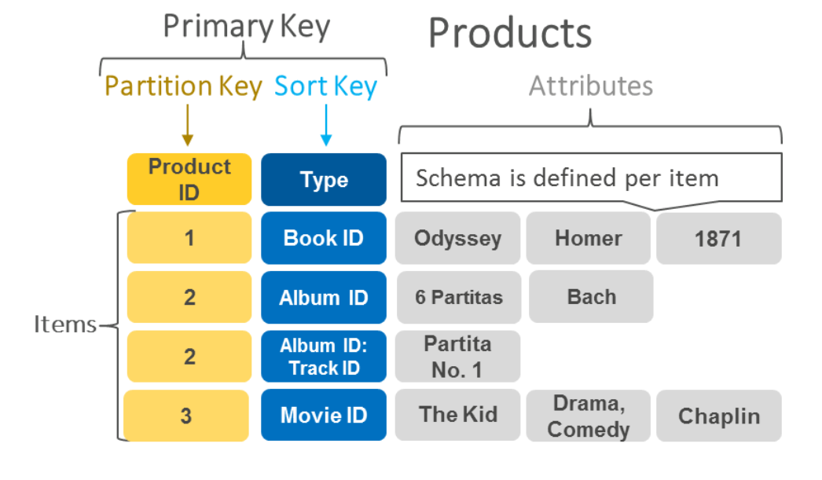
Database Management Systems
An example of data stored as key-value pairs in DynamoDB.
Notes:
https://aws.amazon.com/nosql/key-value/

Slide 147
THANK YOU
Department of Computer Science and Engineering

Slide 148
Database Management Systems
NoSQL – Column Oriented DB
Prof. Bhargavi M & Prof. Vidhyashree DM
Department of Computer Science
and Engineering

Slide 149
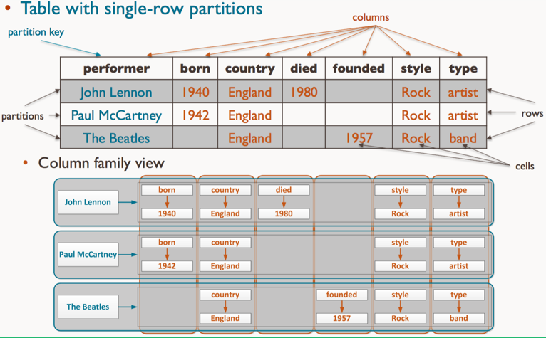
Database Management Systems
Wide-Column Store
A wide-column stores use columns to store data. It can group related columns into column families. Individual rows then constitute a column family.
A typical column family contains a row key as the first column, which uniquely identifies that row within the column family. The following columns then contain a column key, which uniquely identifies that column within the row, so that you can query their corresponding column values.
Notes:
https://studio3t.com/knowledge-base/articles/nosql-database-types/#the-tldr-history-of-nosql

Slide 150
Database Management Systems
Wide-Column Store
Examples of Column Databases
Cassandra – Free, open-source
HBase – Free, open-source
Use Cases
Column stores offer very high performance and a highly scalable architecture. Because they’re fast to load and query, they’ve been popular among companies and organizations dealing with big data, IoT, and user recommendation and personalization engines.
Spotify uses Cassandra to store user profile attributes and metadata about artists, songs, etc. for better personalization.
Facebook initially built its revamped Messages on top of HBase, but is now also used for other Facebook services like the Nearby Friends feature and search indexing.
Outbrain uses Cassandra to serve over 190 billion personalized content recommendations.
Notes:
https://studio3t.com/knowledge-base/articles/nosql-database-types/#the-tldr-history-of-nosql

Slide 151
Database Management Systems
Benefits of Column Store Databases
Benefits of Column Store Databases
Some key benefits of columnar databases include:
Compression. Column stores are very efficient at data compression and/or partitioning.
Aggregation queries. Due to their structure, columnar databases perform particularly well with aggregation queries (such as SUM, COUNT, AVG, etc).
Scalability. Columnar databases are very scalable. They are well suited to massively parallel processing, which involves having data spread across a large cluster of machines – often thousands of machines.
Fast to load and query. Columnar stores can be loaded extremely fast. A billion row table could be loaded within a few seconds. You can start querying and analysing almost immediately.

Slide 152
Database Management Systems
Hbase – column based or Wide Column NoSQL system
HBase is a column-oriented database that prides itself on its ability to provide both consistency and scalability.
HBase is a Apache product and is inspired by BigTable 's white paper and it is open source.
HBase stores data in buckets it calls tables, which contain cells that appear at the intersection of rows and columns.
Hbase tables don’t behave like relations, rows don’t act like records, and columns are completely variable and not enforced by any predefined schema
HBase has some built-in features that other databases lack, such as versioning, compression, garbage collection (for expired data) and in-memory tables
HBase guarantees atomicity at the row level, which means that you can have strong consistency guarantees at a crucial level of HBase’s data model

Slide 153
Database Management Systems
HBase
HBase is designed to be fault tolerant. Hardware failures may be uncommon in individual machines but, in large clusters, node failure is the norm (as are network issues).
HBase can gracefully recover from individual server failures because it uses both write-ahead logging, which writes data to an in-memory log before it’s written (so that nodes can use the log for recovery rather than disk), and distributed configuration, which means that nodes can rely on each other for configuration rather than on a centralized source.
HBase is part of the Hadoop ecosystem, where it benefits from its proximity to other related tools
HBase supports three running modes:
Standalone mode is a single machine acting alone.
Pseudo-distributed mode is a single node pretending to be a cluster.
Fully distributed mode is a cluster of nodes working together.

Slide 154
Database Management Systems
Hbase Data model and Versioning
Hbase data model:
The data model in Hbase organizes data using the concepts of namespaces, tables, column families, column qualifiers, columns, rows, and data cells.
A column is identified by a combination of (column family:column qualifier).
Data is stored in a self-describing form by associating columns with data values, where data values are strings.
Hbase also stores multiple versions of a data item, with a timestamp associated with each version
unique keys are associated with stored data items for fast access
Notes:
Reference Book Navathe Section 24.5.1

Slide 155
Database Management Systems
Hbase Data model and Versioning
Hbase data model:
Tables and Rows
Column Families, Column Qualifiers, and Columns
Versions and Timestamps
Cells
Namespaces
Notes:
Reference Book Navathe Section 24.5.1

Slide 156
Database Management Systems
Examples in Hbase
Creating a table EMPLOYEE with column families: Name, Address, and Details
create ‘EMPLOYEE’, ‘Name’, ‘Address’, ‘Details’
Inserting some in the EMPLOYEE table
put ‘EMPLOYEE’, ‘row1’, ‘Name:Fname’, ‘John’
put ‘EMPLOYEE’, ‘row1’, ‘Name:Lname’, ‘Smith’
put ‘EMPLOYEE’, ‘row1’, ‘Name:Nickname’, ‘Johnny’
put ‘EMPLOYEE’, ‘row1’, ‘Details:Job’, ‘Engineer’
put ‘EMPLOYEE’, ‘row1’, ‘Details:Review’, ‘Good’
put ‘EMPLOYEE’, ‘row2’, ‘Name:Fname’, ‘Alicia’
put ‘EMPLOYEE’, ‘row2’, ‘Name:Lname’, ‘Zelaya’
put ‘EMPLOYEE’, ‘row2’, ‘Name:MName’, ‘Jennifer’
put ‘EMPLOYEE’, ‘row2’, ‘Details:Job’, ‘DBA’
put ‘EMPLOYEE’, ‘row2’, ‘Details:Supervisor’, ‘James Borg’
Some CRUD operations of Hbase
Notes:
Reference Book Navathe Section 24.5.1

Slide 157
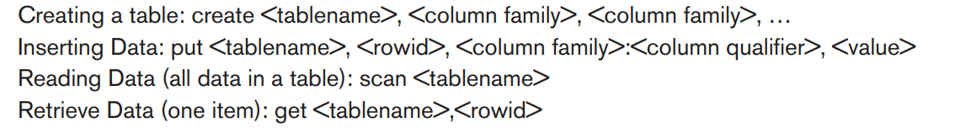
Database Management Systems
Examples in Hbase
Some CRUD operations of Hbase
Notes:
Reference Book Navathe Section 24.5.1

Slide 158
THANK YOU
Department of Computer Science and Engineering

Slide 159
Database Management Systems
NoSQL - Graph Database – Neo4J
Prof. Bhargavi M & Prof. Vidhyashree DM
Department of Computer Science
and Engineering

Slide 160
Database Management Systems
Graph database
A graph database is a database designed to treat the relationships between data as equally important to the data itself.
It is intended to hold data without constricting it to a pre-defined model. Instead, the data is stored like we first draw it out - showing how each individual entity connects with or is related to others
While RDBMS compute relationships at query time through expensive JOIN operations, a graph database stores connections alongside the data in the model.
Accessing nodes and relationships in a native graph database is an efficient, constant-time operation and allows you to quickly traverse millions of connections per second per core.

Slide 161
Database Management Systems
Graph Model
Nodes are the entities in the graph. They can hold any number of attributes (key-value pairs) called properties. Nodes can be tagged with labels, representing their different roles in your domain. Node labels may also serve to attach metadata (such as index or constraint information) to certain nodes.
Relationships provide directed, named, semantically-relevant connections between two node entities (e.g. Employee WORKS_FOR Company). A relationship always has a direction, a type, a start node, and an end node. Like nodes, relationships can also have properties. In most cases, relationships have quantitative properties, such as weights, costs, distances, ratings, time intervals, or strengths. Due to the efficient way relationships are stored, two nodes can share any number or type of relationships without sacrificing performance. Although they are stored in a specific direction, relationships can always be navigated efficiently in either direction.

Slide 162
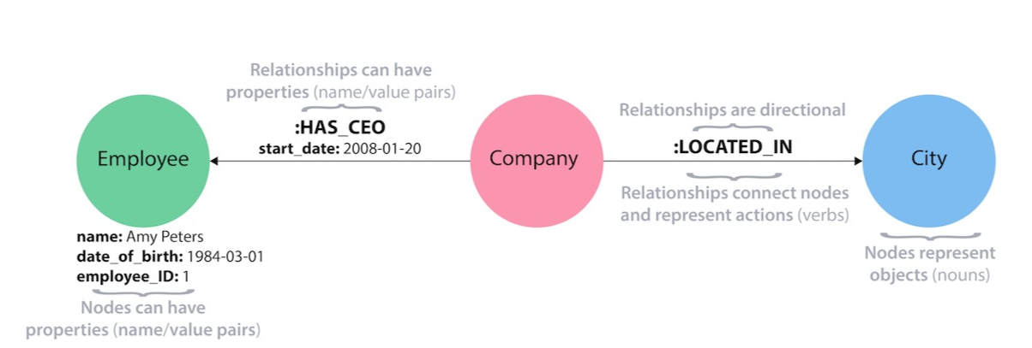
Database Management Systems
Graph Model Example

Slide 163
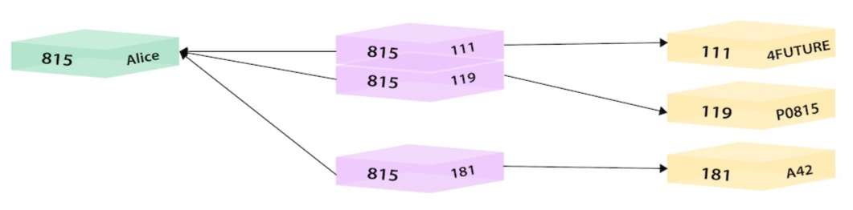
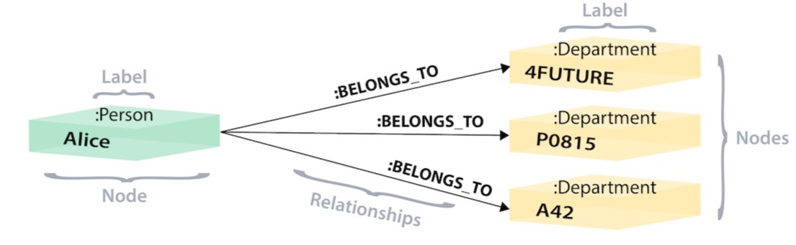
Database Management Systems
Relational vs Graph Model Example
Relational Model
Graph Model

Slide 164
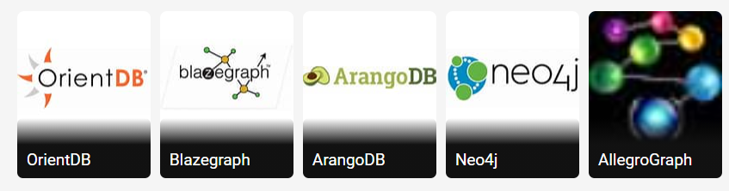
Database Management Systems
Graph Databases
ArangoDB,
Oracle NoSQL database
Neo4j
OrientDB
AllegroGraph
BlazeGraph
Dgraph and many more….

Slide 165

Database Management Systems
Neo4J
Neo4J is the most popular graph database used by: Adobe, Cisco, Glassdorr, Huawei, HP….
Neo4j is the world's leading open source Graph Database which is developed using Java technology. It is highly scalable and schema free (NoSQL).
Neo4J uses Graph model: Nodes and Relationships (to connect nodes)

Slide 166

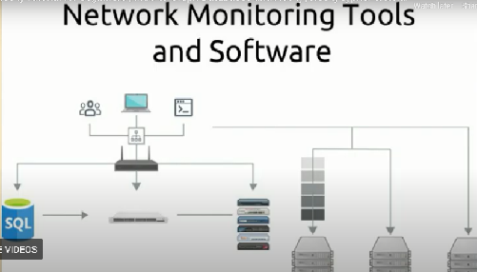
Database Management Systems
Neo4j – Graph DB - Use cases
Fraud detection and analytics – to detect financial crimes through credit cards, ecommerce and money laundering,
Network Monitoring Tools and Software
Notes:
Neo4j Tutorial for beginners | Intro to Graph Databases and Neo4j | Neo4j cypher tutorial - Bing video
Neo4j Graph Database: Use Cases and Real-life Examples (rubygarage.org) 🡪 scroll down for information

Slide 167
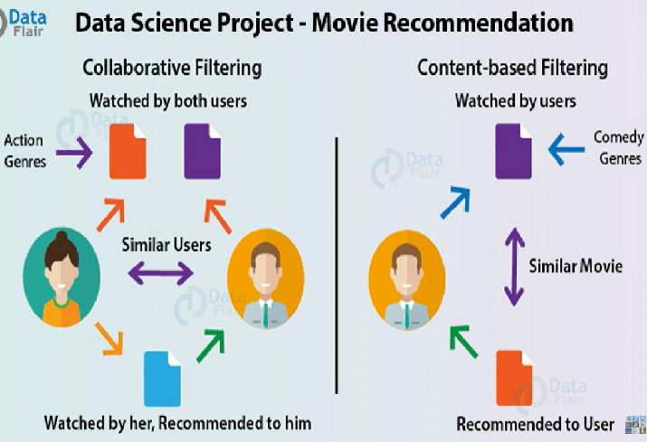

Database Management Systems
Neo4j – Graph DB - Use cases
Recommendation Engines and Social Networking
Notes:
Neo4j Graph Database: Use Cases and Real-life Examples (rubygarage.org) 🡪 scroll down

Slide 168
Database Management Systems
Organisations using Neo4j
Walmart
Ebay
Adbode
Nasa
Microsoft
IBM
Airbnb
Notes:
Neo4j Tutorial for beginners | Intro to Graph Databases and Neo4j | Neo4j cypher tutorial - Bing video

Slide 169
Database Management Systems
RDBMS / Graph DB
RDBMS is strictly structured, with tables, rows and columns
Developers and Applications should adhere to this strict table structure
Need complex queries with are memory and computational intensive
Understanding the structure in huge database is challenging
So….use graph database
Graph has nodes and realtionship, each node has properties
Social network is a good example of graph, people are nodes with properties name, age, dob and can play roles like manager, employee, friend…… These roles represents relationship
Graph db uses query language called CQL (cypher query language) which was originally developed for Neo4J
Suitable when data is highly interconnected
Notes:
Neo4j Tutorial for beginners | Intro to Graph Databases and Neo4j | Neo4j cypher tutorial - Bing video

Slide 170
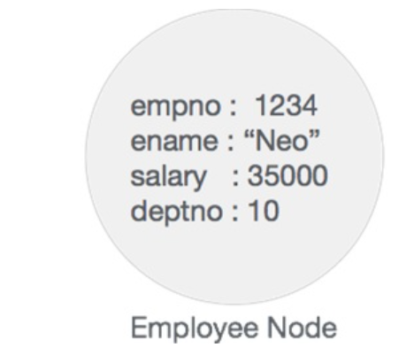
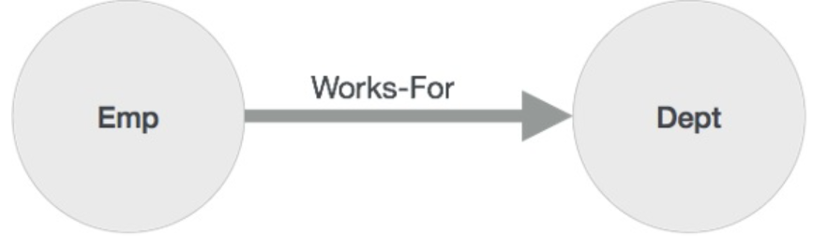
Database Management Systems
Neo4j building blocks
Node is a fundamental unit of a Graph. It contains properties with key-value pairs as shown in the following image.
Node Name = "Employee" and it contains a set of properties as key-value pairs.
Property is a key-value pair to describe Graph Nodes and Relationships.
Key=Value
Where Key is a String and Value may be represented using any Neo4j Data types.
Relationships connects nodes, Emp and Dept are two different nodes. "WORKS_FOR" is a relationship between Emp and Dept nodes. The arrow mark from Emp to Dept, describes relationship. Emp worksfor Dept
Label associates a common name to a set of nodes or relationships. A node or relationship can contain one or more labels.
Emp, Dept and worksfor are labels

Slide 171
Database Management Systems
Neo4J - CQL
Oracle DB (RDBMS) has query language SQL, Neo4j has CQL as query language.
CQL stands for Cypher Query Language.
Neo4j CQL:
Is a query language for Neo4j Graph Database.
Is a declarative pattern-matching language.
Follows SQL like syntax.
Syntax is very simple and in human readable format

Slide 172
Database Management Systems
Neo4J – Create and View a Single Node
Create a node:
Create (n)
// creates a single node
// n is an identifier and not the name of the node.
Output: Created one node in “xyz” ms
View a node:
Match(n) return(n);
//Fetches a node created in the database
//node is printed with internal property: “id”
// id is used for internal usage, starts from zero and each node will have only one internal id and unique in the database and auto generated by database
Notes:
n can be used in other queries also

Slide 173
Database Management Systems
Neo4J – Create and View Multiple Nodes
Create multiple nodes:
Create (n) , (m)
// creates two nodes successfully. n and m are identifiers/variables
Output: Created two nodes in “xyz” ms
View all nodes created:
Match(n) return n;
//Fetches the nodes created in the database
Output: 3 nodes are displayed including the one created in previous slide
View some nodes:
Match(n) return n limit 2
//Restrict the number of nodes by using limit clause Output: Displays first 2 nodes with id 0 and 1

Slide 174
Database Management Systems
Neo4J – Search Nodes by id’s
Search a node by internal id:
match (n) where id(n) =1 return n
// id built in function of Neo4j, returns the internal id of the node when used with where clause
Output: Displays the node with internal id=1
Comparison operator to filter out the nodes (<,>,<=,>=,<>):
To fetch the node with internal id <=6
Match(n) where id(n)<=6 return n
Output: Displays all 7 nodes (node with id =0,1,2,3,4,5,6)
Search multiple nodes with internal id’s (using in clause)
Match(n) where id(n) in [1,2,0] return n
Output: Displays 3 nodes with id 0, 1, 2

Slide 175
Database Management Systems
Neo4J – Delete nodes and Database
Delete a node by its internal id:
match (n) where id(n) =1 delete n
// deletes the node that matches the where clause ie deletes a node with id=1
Output: Deleted one node in “xyz” ms
Delete multiple nodes with id:
Match(n) where id(n) in [2,3] delete n
// two nodes are deleted with internal id 2 and 3
Output: Deleted two nodes in “xyz” ms
Delete all nodes
Match(n) delete n
//delete all the nodes in the database if there are no relationships in the graph
Output: Deleted “x” nodes in “xyz” ms

Slide 176
Database Management Systems
Neo4J – Delete nodes and Database (contd..)
Deleting entire DB:
sudo rm –rf /var/lib/neo4j/data/*
// delets entire graph directory
//all the data is stored in the graph director, so need to delete the graph directory.
// Before this stop the neo4j server using command sudo service neo4j stop
// later restart the server and check in neo4j graphical interface that no data is available in db, can use neo4j from scratch.
Sudo service neo4j start -> to start the server
Sudo service neo4j stop -> to stop the server
Sudo service neo4j status -> to check the status of the server (running/stopped)

Slide 177
Database Management Systems
Neo4J – Create and Search nodes with labels
Labels are the tags that can be associated to nodes, labels can be used to group the nodes
Labels are optional and each node can have multiple labels
Any valid Unicode string can be used as a label
Creating a node with a label:
Create (n:Person)
Output: Added 1 label, created 1 node, statement executed in “xyz” ms
// creates a node with label Person
// label is represented by a colon followed by name of the label and can be applied only to nodes.
// by convention use Camel case

Slide 178
Database Management Systems
Neo4J – Create and Search nodes with labels
Search node with a labels:
Match (n) where n:Person return n
// returns a node with label Person
// displays both the id and label of the node
Create a node with multiple labels:
create (n : Person : Indian)
Output: Added 2 labels, created 1 node, statement executed in “xyz” ms
// a node is created with two labels (person and Indian)
// a node can have multiple labels and a label can have multiple nodes
// a node can have multiple labels as it can represent multiple things at the same time

Slide 179
Database Management Systems
Neo4J – Create and Search nodes with labels (Contd..)
Search node by multiple labels:
Match (n) where n:Person:Indian return n
// returns all the nodes with label Person and Indian
// displays both the id and label of the node
Search a node with Person or Indian label or both:
Match (n) where n :Person or n :Indian return n
//returns nodes with the label Person or with the label Indian or both

Slide 180
Database Management Systems
Neo4J – Create and Search nodes with labels (Contd..)
Search node by multiple labels:
Match (n) where n:Person:Indian return n
// returns all the nodes with label Person and Indian
// displays both the id and label of the node
Search a node with Person or Indian label or both:
Match (n) where n :Person or n :Indian return n
//returns nodes with the label Person or with the label Indian or both
Notes:
Create few nodes with label person and few with label Indian and few with both

Slide 181
Database Management Systems
Neo4J – Add Labels to node
Add label to an existing node using set clause:
Match (n) set n:Employee return n
// add’s a label Employee to all the nodes in the database
Add multiple labels to all nodes in database
Match (n) set n:Vacation:Food return n
// add’s a label Vacation and Food to all the nodes in the database
Add label to a single selected node by using id:
Match (n) where id (n) =1 set n:Manager return n
//add’s a label Manager to the node with the internal id=1
Notes:
Create a node initially without label for first query

Slide 182
Database Management Systems
Neo4J – Add Labels to node (Contd..)
Add label to multiple selected nodes:
Match (n) where id (n) in [2,3] set n: TeamLeader return n
//add’s a label “TeamLeader” to the nodes with internal id 2 and 3.
Notes:
Create a node initially without label for first query

Slide 183
Database Management Systems
Neo4J – Remove/Update Labels to node (Contd..)
Remove a label from all nodes in database:
Match (n) remove n:Person return n
//remove’s label “Person” from all the nodes
Remove a label from selected nodes:
match (n) where id(n) in [2,3] remove n:Employee return n
//remove’s label “Employee” from the nodes with id 2 and 3.
Remove multiple labels from all nodes in database:
Match (n) remove n:Food:Vacation return n
//remove’s label Food and vacation from all the nodes which has both or either of these labels
Notes:
Remove clause helps to remove a label or property
Delete clause helps to delete a node or a relationship
Both are used with match clause

Slide 184
Database Management Systems
Neo4J – Remove/Update Labels to node (Contd..)
Update a label of a node:
Match (n) where id(n) = 0 remove n:Manager set n:Director return n
//update’s label of the node with internal id 0 from Manager to Director and return the node
List all labels of all nodes:
match (n) return distinct labels(n);
// display’s all labels existing in db
// distinct removes duplicate labels and node labels are case sensitive
Listing all labels for a node:
Match (n) where id(n)=0 return distinct labels(n)
//list all the labels associated with node with id=0

Slide 185
Database Management Systems
Neo4J – Remove/Update Labels to node (Contd..)
Update a label of a node:
Match (n) where id(n) = 0 remove n:Manager set n:Director return n
//update’s label of the node with internal id 0 from Manager to Director and return the node
List all labels of all nodes:
match (n) return distinct labels(n);
// display’s all labels existing in db
// distinct removes duplicate labels and node labels are case sensitive
Listing all labels for a node:
Match (n) where id(n)=0 return distinct labels(n)
//list all the labels associated with node with id=0

Slide 186
Database Management Systems
Neo4J – Remove/Update Labels to node (Contd..)
Count the labels available in db:
Match (n) return distinct count (labels(n));
//displays number of distinct labels in db
List all labels of all nodes:
Match (n) return distinct count (labels(n)),labels(n);
// returns label along with the label counts
Delete a node with a given label:
Match (n) where n:TeamLeader delete n
// deletes all the nodes with the label TeamLeader

Slide 187
Database Management Systems
Neo4J – Create a node with properties
Create a node with properties (Properties are attributes of a node)
Properties are always associated with a node or relationship
Properties are optional attributes which are represented as key-value pairs as ({})
A node can have zero or more properties
Creating a node with a single property:
create (x: Labelname {Property name: Value}) return x;
create (x: Book {title : “The Bengal Tiger”}) return x;
// creates a node with label Book and a property named title with its value “The Bengal Tiger”

Slide 188
Database Management Systems
Neo4J – Create a node with properties
Creating a node with multiple single properties:
Pair of properties are separated by comma
create (x: Labelname {Property_name: Value, Property_name : value}) return x;
create (x: Book {title : “Database System”, author: “Navathe”, publisher : “Prearson”}) return x;
// creates a node with label Book with 3 properties.
//property names are case sensitive and can contain underscore and alpha numeric characters
//must start with a letter
create (x: Book1 {title : “Database System”, author: “Navathe”, Author : “Elmasri”}) return x;
// creates a node with label Book1 with 3 properties.

Slide 189
Database Management Systems
Neo4J – Data Types
To define properties of a node
Property is of the form Key : Value pair
Key is the name of the property – String
Value can be primitive data type or can be array of primitive datatypes
List of Primitive datatypes:
Boolean, integer, double, long, character, string
Array of primitive datatypes:
Boolean array, int array, double array, long array, char array, string array
// null is not a valid value for the property

Slide 190
Database Management Systems
Neo4J – Data Types
To define properties of a node
Property is of the form Key : Value pair
Key is the name of the property – String
Value can be primitive data type or can be array of primitive datatypes
List of Primitive datatypes:
Boolean, integer, double, long, character, string
Array of primitive datatypes:
Boolean array, int array, double array, long array, char array, string array
// null is not a valid value for the property

Slide 191
Database Management Systems
Neo4J – Data Types
To create a node with properties of different datatype:
Create (x:Book { title:”the lives of others”, author : “Neel”, publisher: [“Chato & Windos”,”w norton”], price: 285.00, pages : 528, instock : false }) return x
// Creates a node with label Book and 6 properties, where title, author property is of type string, publisher of type string array, price is of type float, page is of type integer and instock is of type Boolean.
// creates a node with 6 properties as specified in query
Create (x:Book{details:[“the nagas”,172.00,398]}) return x;
// collections containing mixed types cannot be stored in properties, considers the datatype of first value
Create (x:Book{details:[“the nagas”,”172.00”,”398”]}) return x;
//Successfull

Slide 192
Database Management Systems
Neo4J – Search nodes by using properties
To filter a node with properties and with specific value:
There are multiple nodes with label book and associated with properties like author, title, pages, price and publisher
Search all nodes where author of the book is “Chetan ”
Match (n:Label{property:”value”}) return n;
Match (n:Book{author:”Chetan”}) return n;
// return all the nodes with label book and property author with value “Chetan” , if not available returns zero records
Match (n:Book1{Author:"Elmasri"}) return n;
// returns nodes with label Book1 and Author value Elmasri

Slide 193
Database Management Systems
Neo4J – Search nodes by using properties
To filter a node using operators (AND, OR, < , >……)
Search all nodes whose author is a1 or a2 and price of the book is one thousand.
Match (n:Book) where n.price<1000 AND (n.author="Neel" or n.author = "Navathe") return n;
// return all the nodes with label book with price <1000 and author with value Neel or Navathe

Slide 194
Database Management Systems
Neo4J – Update properties of a Node
We created:
Create (x:Book { title:”the lives of others”, author : “Neel”, publisher: [“Chato & Windos”,”w norton”], price: 285.00, pages : 528, instock : false }) return x
To change the title of the Book
Match(n) where n.title=“the lives of others” set n.title=“The lives” return n
//updates the title from “the lives of others” to “the lives” and returns the node

Slide 195
Database Management Systems
Neo4J – Update properties of a Node
To update multiple properties:
Match(n:Book {title=“existing title}) set n.author=“Gosh”,n.price=324.00,n.stock=true return n
//Searches for the nodes with label Book and title =“existing title” and update its author, price and stock properties accordingly.

Slide 196
Database Management Systems
Neo4J – Delete properties of a Node
To delete multiple properties:
Match clause is used to search and remove clause to delete certain property.
Method 1: Remove property by setting the value to NULL
Match(n:Book {author:“Neel”}) set n.publisher=NULL return n
//to remove - set publisher to null from the nodes with label Book and author “Neel”
//This removes property publisher.
Method 2: Remove property by setting the value to NULL
Match(n:Book) where n.author = “Neel” set n.publisher=NULL return n

Slide 197
Database Management Systems
Neo4J – Delete properties of a Node
To delete property from all the nodes
Use Match clause to get all the nodes and remove clause to delete certain property from all.
Method 1: Remove property “pages” from all nodes
Match (n) remove n.pages return n
//to remove property pages from all the nodes
Method 2: Remove property “title” from the nodes with label bestseller
Match(n) where n:Bestseller remove n.title return n;
//a property can be used as a filter to delete other properties

Slide 198
Database Management Systems
Neo4J – Delete properties of a Node
To delete the nodes
Use match clause to select and delete clause to delete a node
Match (n) n.stock=false delete n
//to delete nodes based on the property stock with value “false”
// based if id the properties can be deleted
Remove a property named price from the node with the internal id = 1
Match(n) where id(n)=1 remove n.price return n

Slide 199
Database Management Systems
Neo4j Relationship
We can create a relationship using the CREATE clause. We will specify relationship within the square braces “[ ]” depending on the direction of the relationship it is placed between hyphen “ - ” and arrow “ → ” as shown in the following syntax.
Format : create (node1) – [:RelationshipType]->(node2)
Create two nodes and then relation ship between them
Create (chetan:author{name:”Chetan”,dob:1980,age:41})
Create (nagas:Book{title:”Nagas”,price:200,publication:”westland publication”}
//above to queries creates 2 nodes
Create (chetan)-[r:author_of]->(nagas)
//above query to create relationship between them

Slide 200
Database Management Systems
Neo4j Relationship
We can create a relationship using the CREATE clause. We will specify relationship within the square braces “[ ]” depending on the direction of the relationship it is placed between hyphen “ - ” and arrow “ → ” as shown in the following syntax.
Format : create (node1) – [:RelationshipType]->(node2)
Create two nodes and then relation ship between them
Create (chetan:author{name:”Chetan”,dob:1980,age:41})
Create (nagas:Book{title:”Nagas”,price:200,publication:”westland publication”}
//above to queries creates 2 nodes
Create (chetan)-[r:author_of]->(nagas)
//above query to create relationship between them

Slide 201
Database Management Systems
Neo4j – CaseStudy - MovieDB
Movide db: neo4j@bolt+s://9b8a365a7edd12fbfff9487677979a87.neo4jsandbox.com:7687/neo4j - Neo4j Browser
Video tutorial: Neo4j Tutorial for beginners | Intro to Graph Databases and Neo4j | Neo4j cypher tutorial - Bing video from 6:13th minute
? -> help has a tutorial and with sample queries
Notes:
Neo4j Tutorial for beginners | Intro to Graph Databases and Neo4j | Neo4j cypher tutorial - Bing video from 6:13th minute

Slide 202
THANK YOU
Department of Computer Science and Engineering

